Slide 1
DermAI
Skin disease detection
Team Thunder Buddies Sprint 4

Slide 2
Agenda
Team Members
Improvement
Project Description
Teamwork agreement
Personas
MVP
Technologies
Algorithms
Diagrams
Sprint 3 recap
Product Backlog(All the Users Stories or Tasks)
Sprint Summary(2 and 3)
Sprint 4 Backlog (Stories or tasks committed)
Test cases
Metrics(Historical velocity)
Retrospective
Sprint 4(Stories planned and committed for Sprint 4)
Project demo (Application Screenshots)
Code snippets
Demo Video of application
Github link

Slide 3
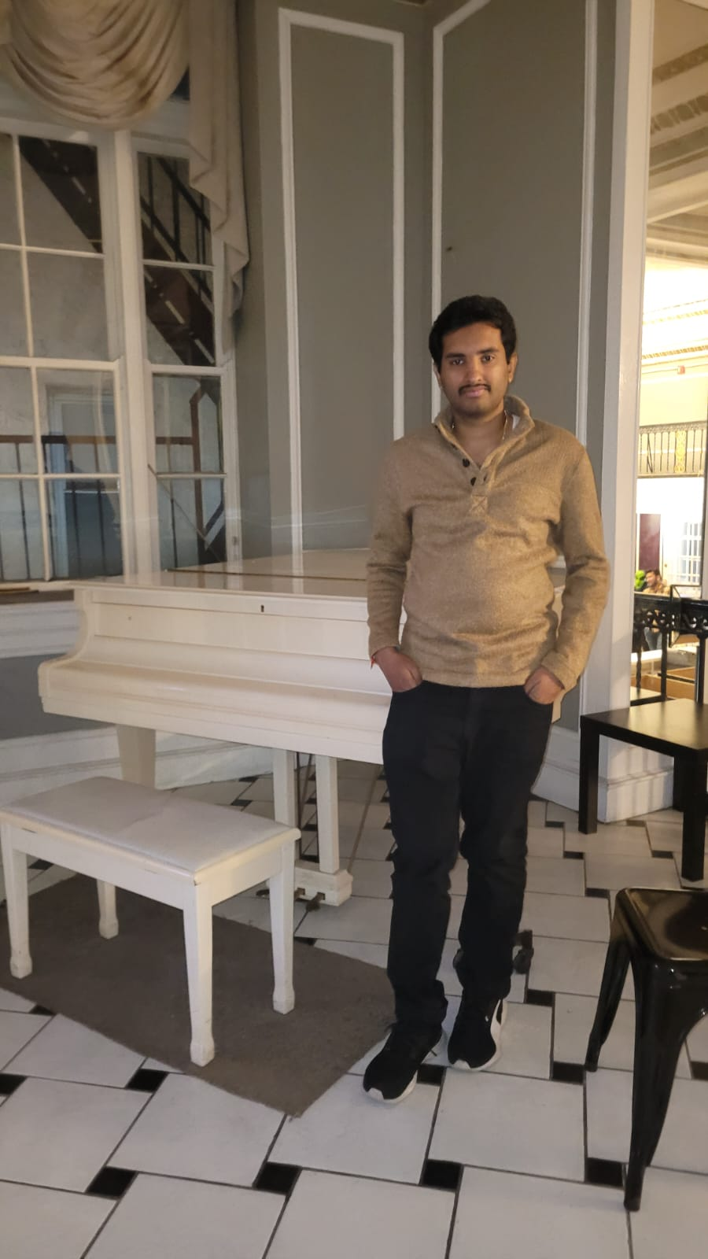
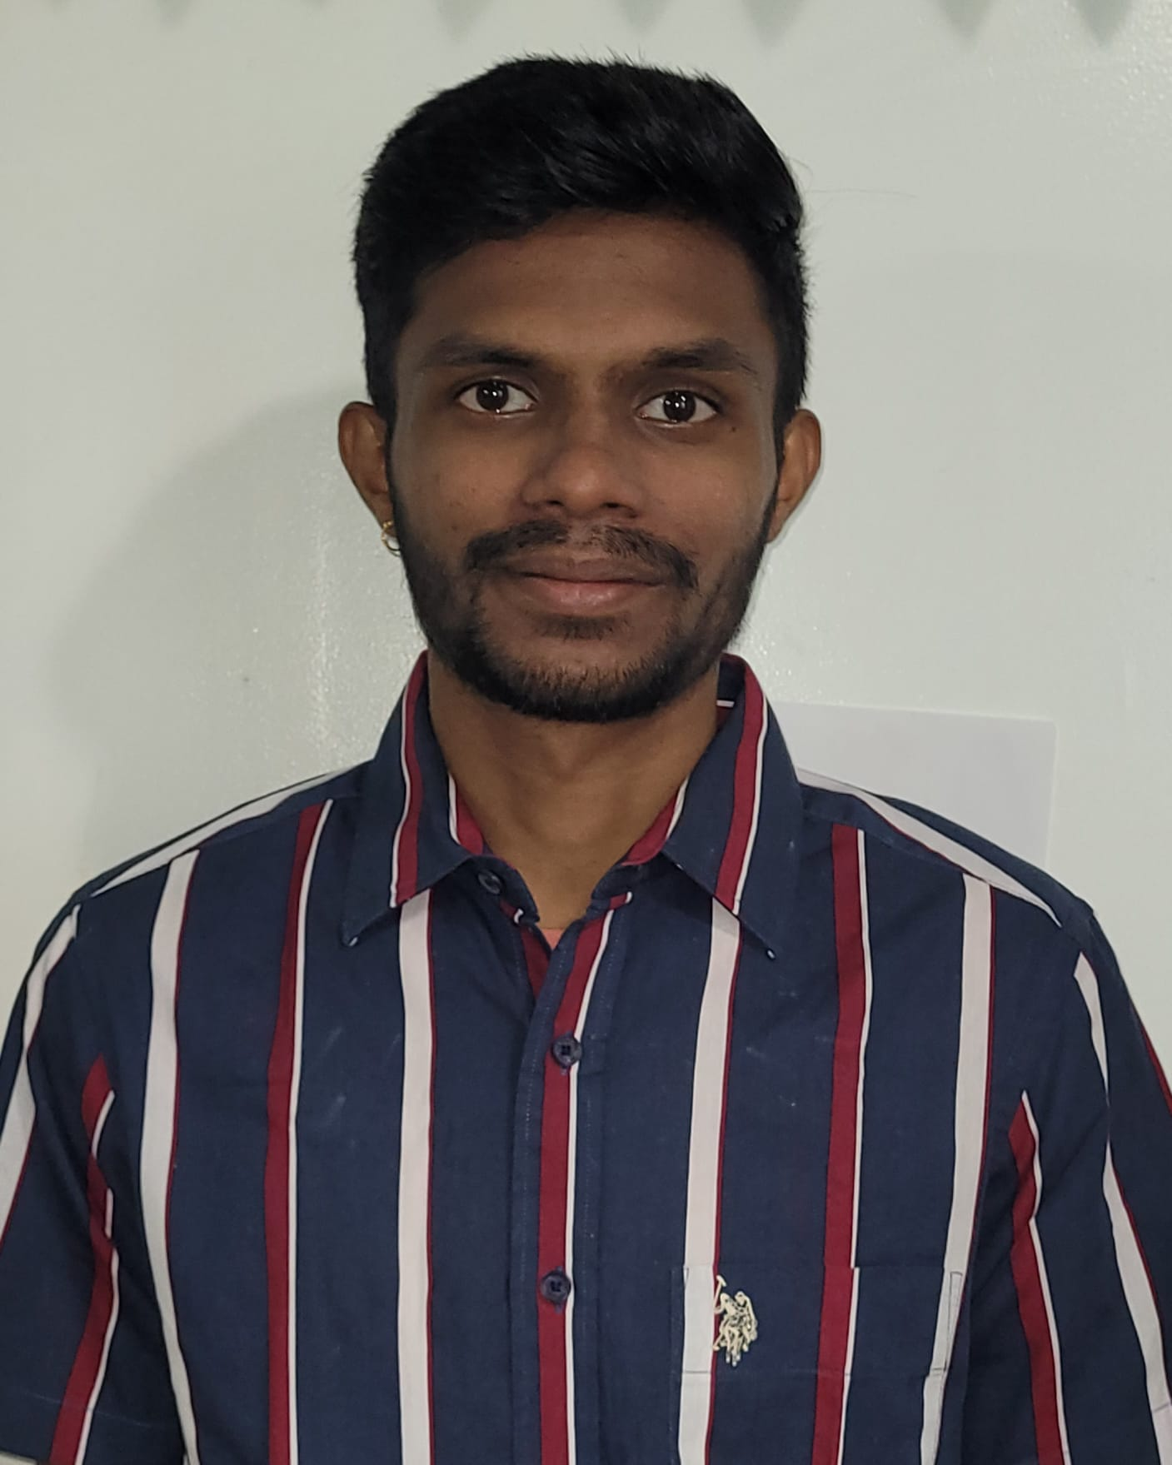
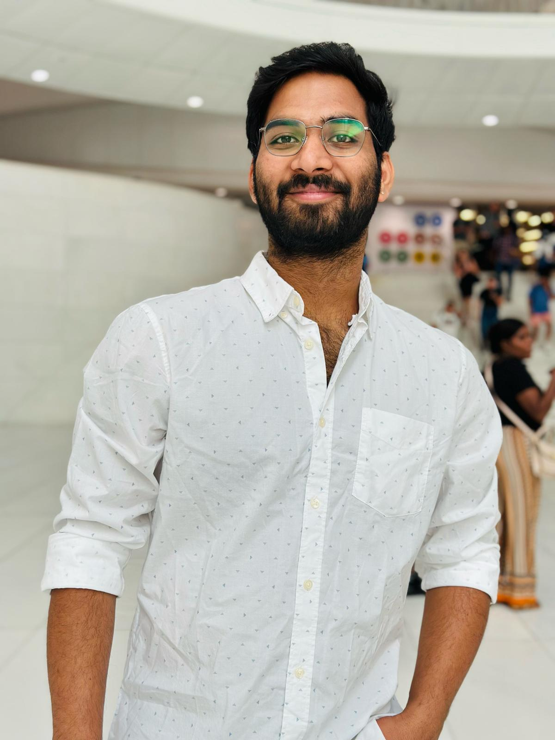
Team Members
Bhargava Chilukuri
Front end developer and scrum master
Kushal arya neela
Front end developer
Manideep Kumar Reddy Kotha
Backend developer

Slide 4
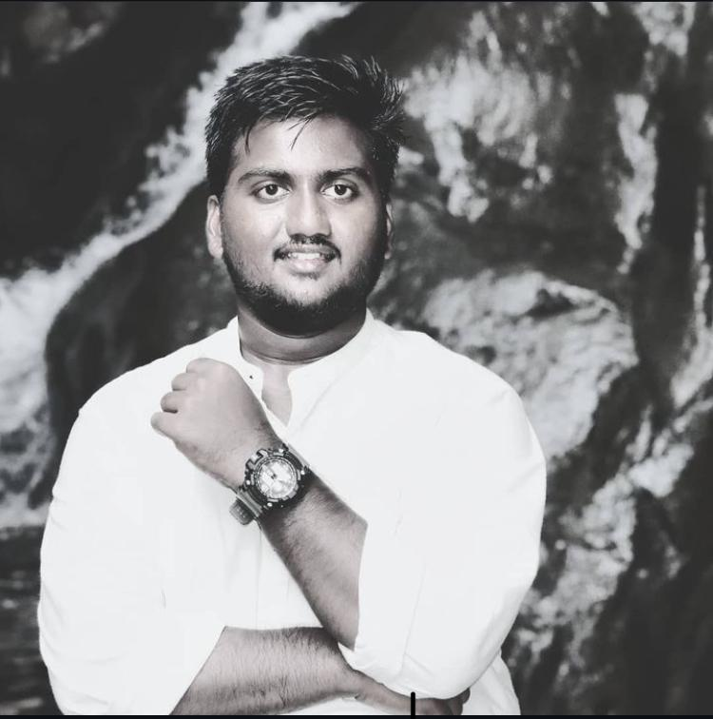
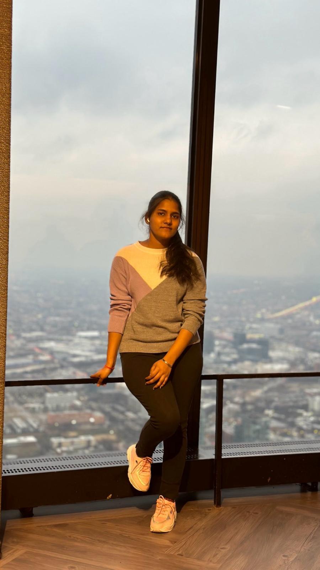
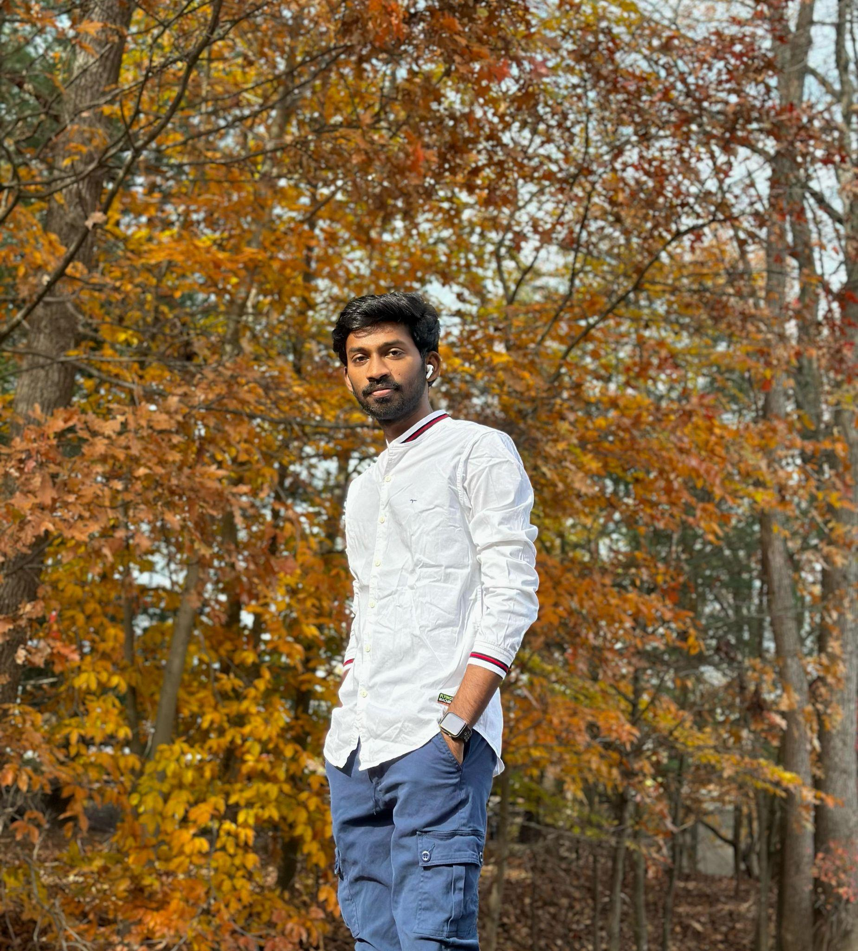
Jagadeesh Mekhapotula
Backend Developer and Tester
Akshara Uppu
Backend Developer
Sai Praneeth Chagiri
Front-end Developer

Slide 5

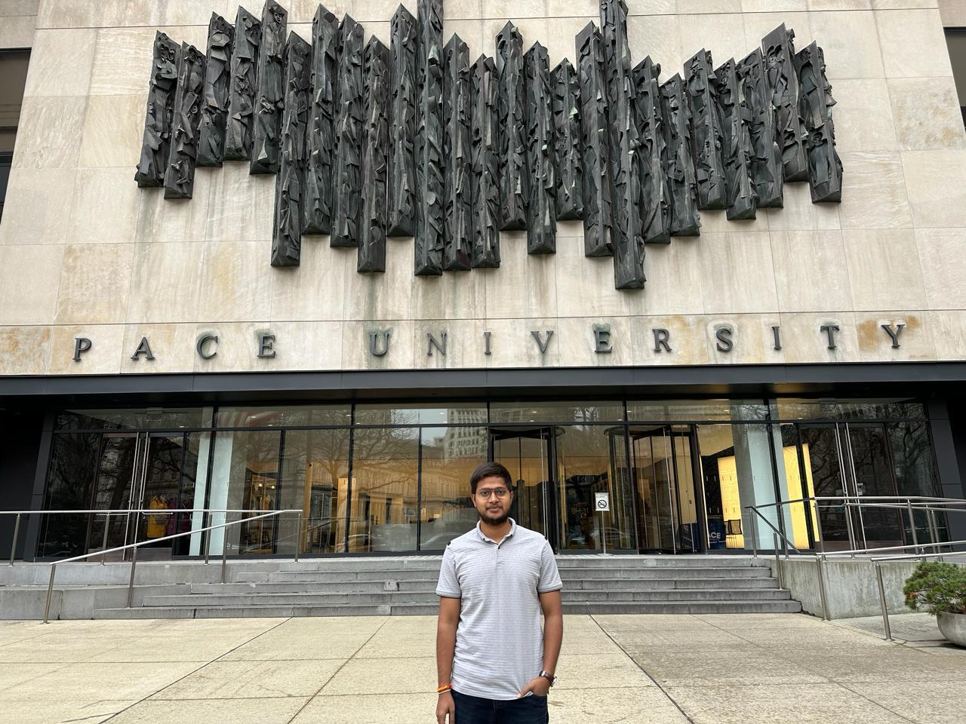
Srinath Madagoni
Machine learning engineer
Manoj Kumar Madhavarapu
Machine learning engineer

Slide 6
Improvements after Professor’s Feedback
Test screen updated and changed product backlog slides
Ordering Project presentation slides
Updates in sprint backlog and burndown chart
Addition of details into application screen
Improved technologies slide and description

Slide 7
Problem Statement
The diagnosis of the dermatological problem is quite complex and requires expert knowledge and accurate results. At present digital solutions lack accuracy and simplicity usage of the application. Thus ,it creates a gap between the human solution and the digital solution. So DermAI comes in place which has a user-friendly interface and employs deep learning to diagnose skin conditions and give precision results. Which empowers everyone from general public to have expert dermatologists in their hands.

Slide 8
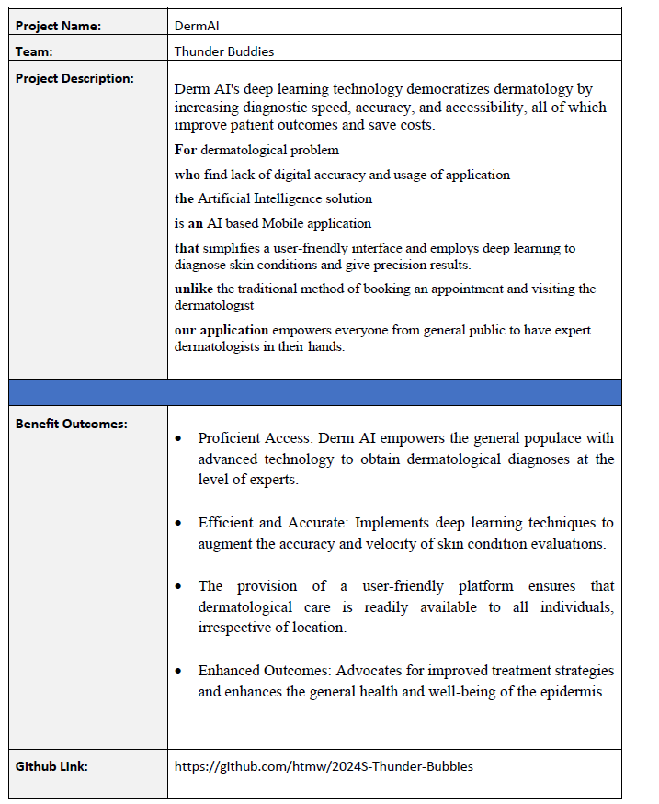
Project Description

Slide 9
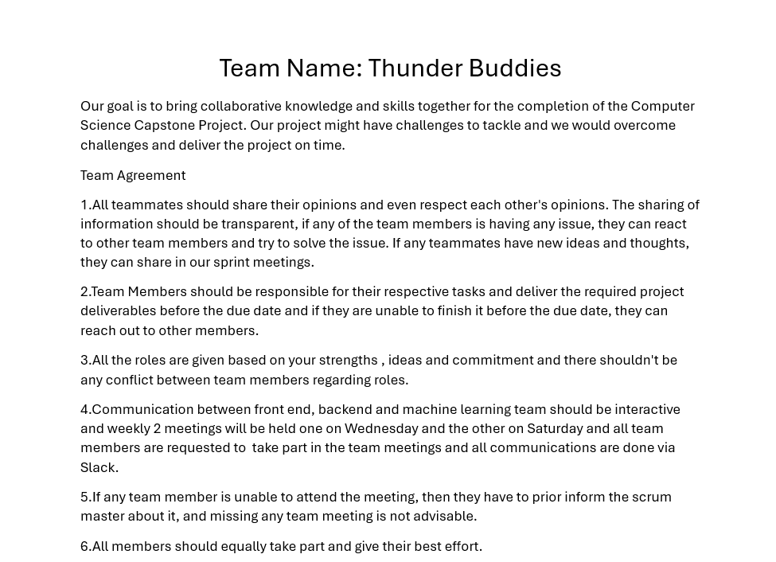
Teamwork Agreement

Slide 10
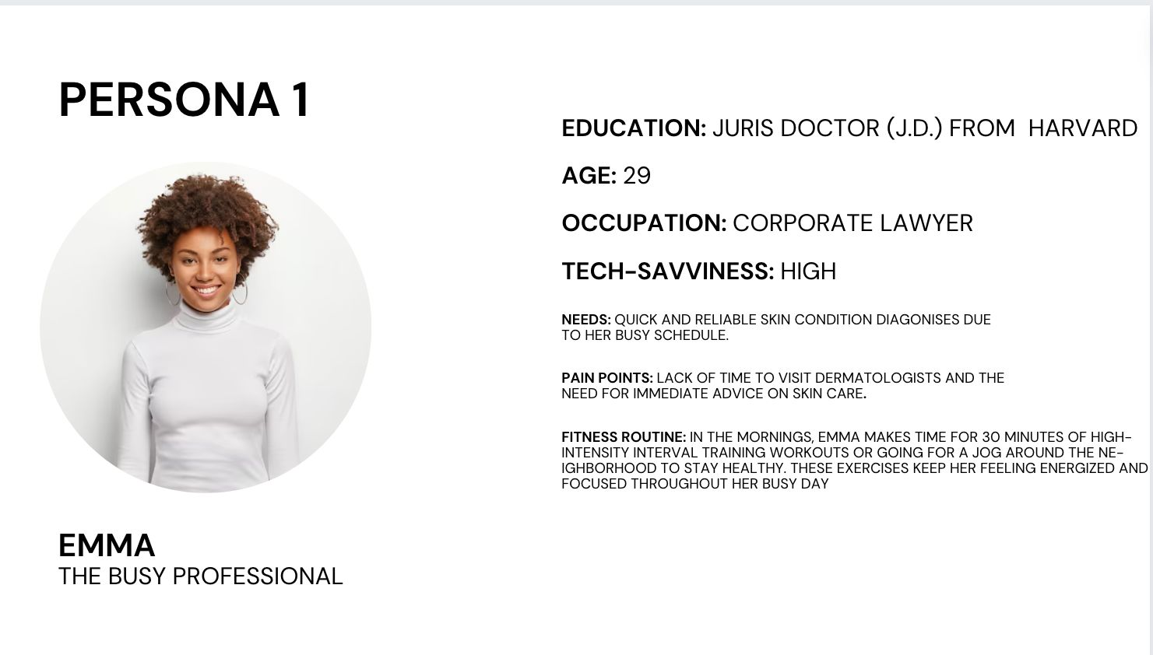

Slide 11
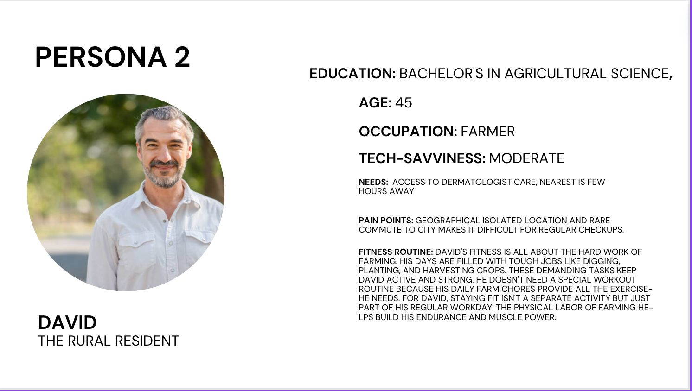

Slide 12
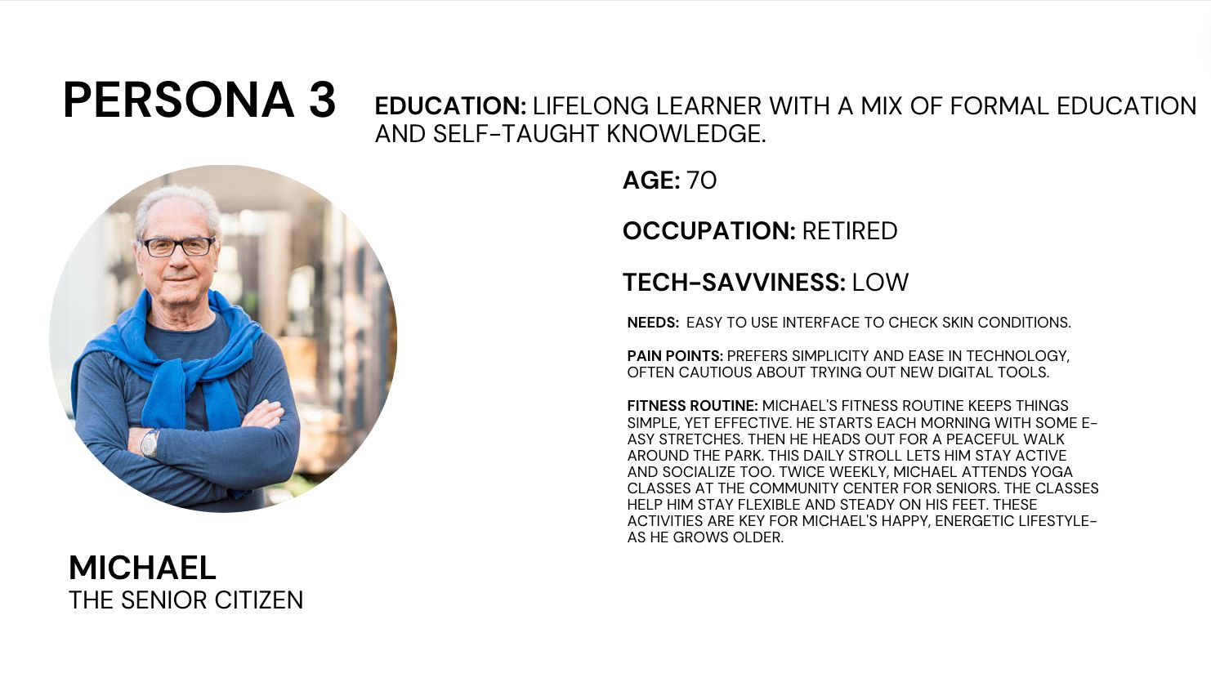

Slide 13
MVP (Minimum Viable Product)
Registration and login page for authentication of user
Upload of Affected Skin picture
Analysis of the Picture and recognition of disease using AI
User Information and detail of the skin disease

Slide 14

Technologies and Tools - Frontend
Expo is react native wrapper which makes developing an mobile application faster and it does most of complex just by npx create-expo-app my-app.

Slide 15


Technologies and tools - Backend
For backend both flask and node js has been used.
Flask is mainly to create a machine learning model api which is going to be connected via node js.
Node js is mainly used to do basic CRUD operations.

Slide 16

Technologies and Tools - Backend
Tensorflow is a machine learning framework and it is used to build Image classification model. For this project, tensorflow is used to build skin disease classification model.

Slide 17



Technologies and Tools
Docker is used for containerizing dependencies which ensures portability, consistency and scalability.
Firebase is used for authentication and database where as digital ocean is used of running the backend code and run those apis on cloud then in local machine.

Slide 18


Technologies and Design Tools
Those 2 are the design tools and these are mainly used for design UI and for flowcharts.
Figma is used for UI design .
Miro is used for designing charts.

Slide 19
Algorithms
CNN Algorithms:
CNNs uses layered architecture to process visual data, extracting features through filters for image recognition tasks.
EfficientNet:
EfficientNet scales CNNs uniformly across width, depth, and resolution, enhancing efficiency and accuracy.

Slide 20
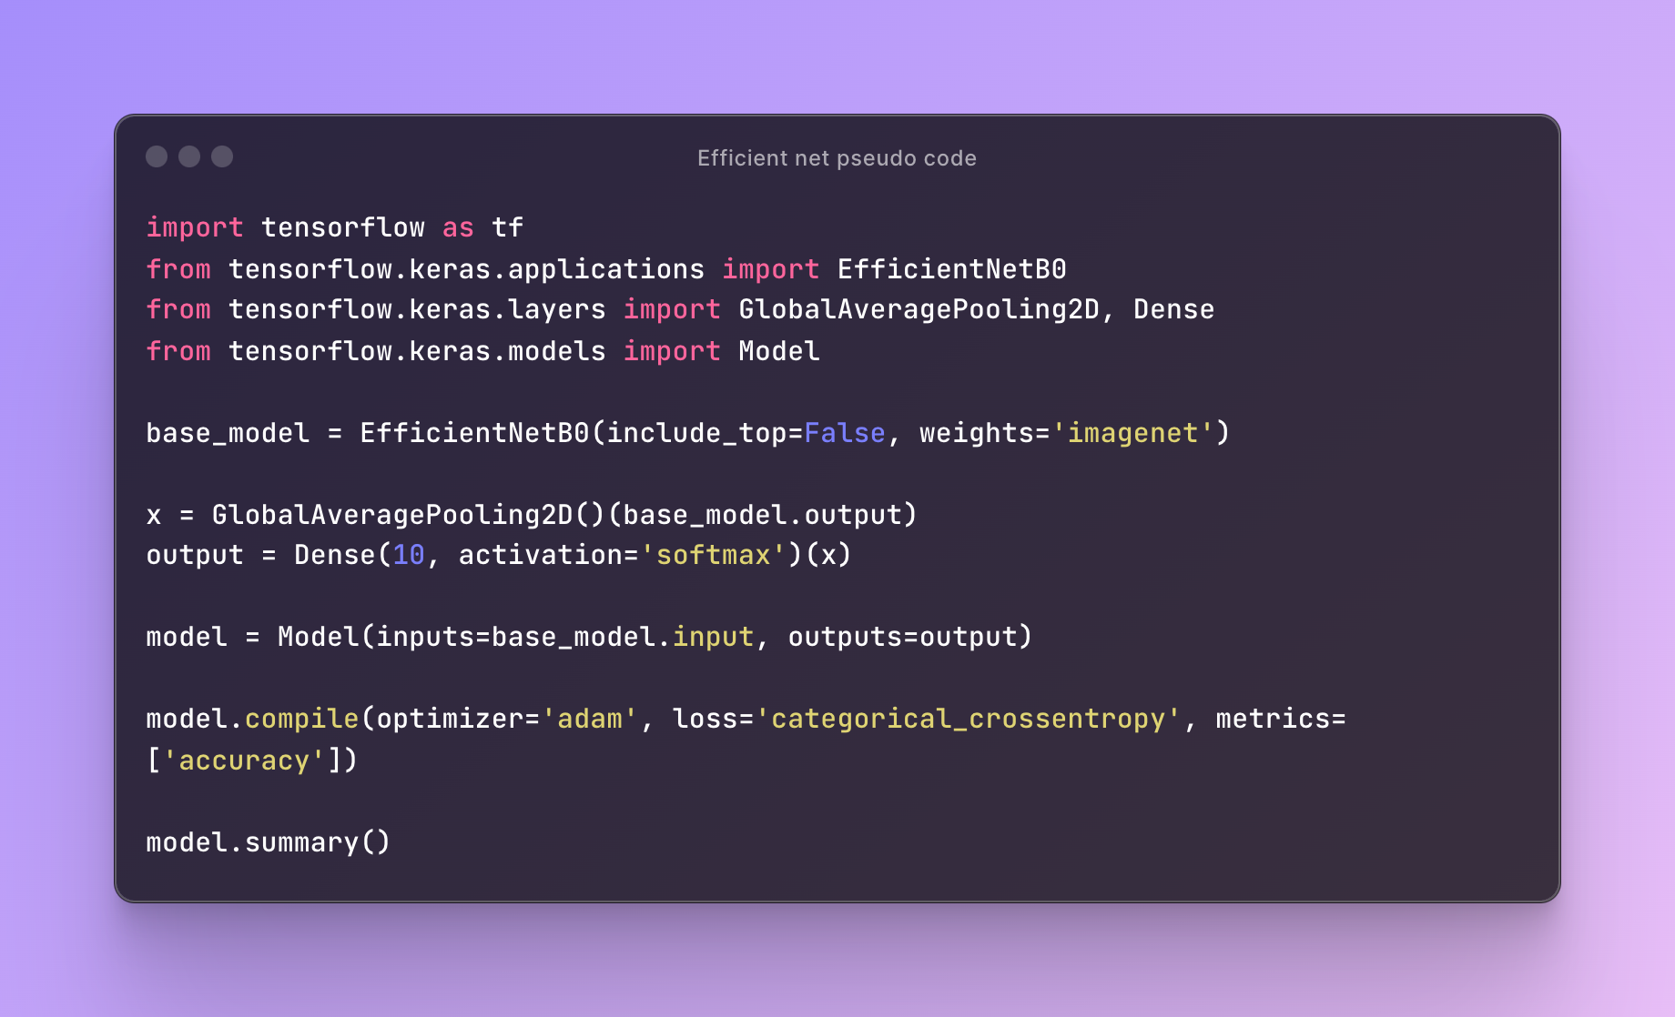
Pseudo Code: ML

Slide 21
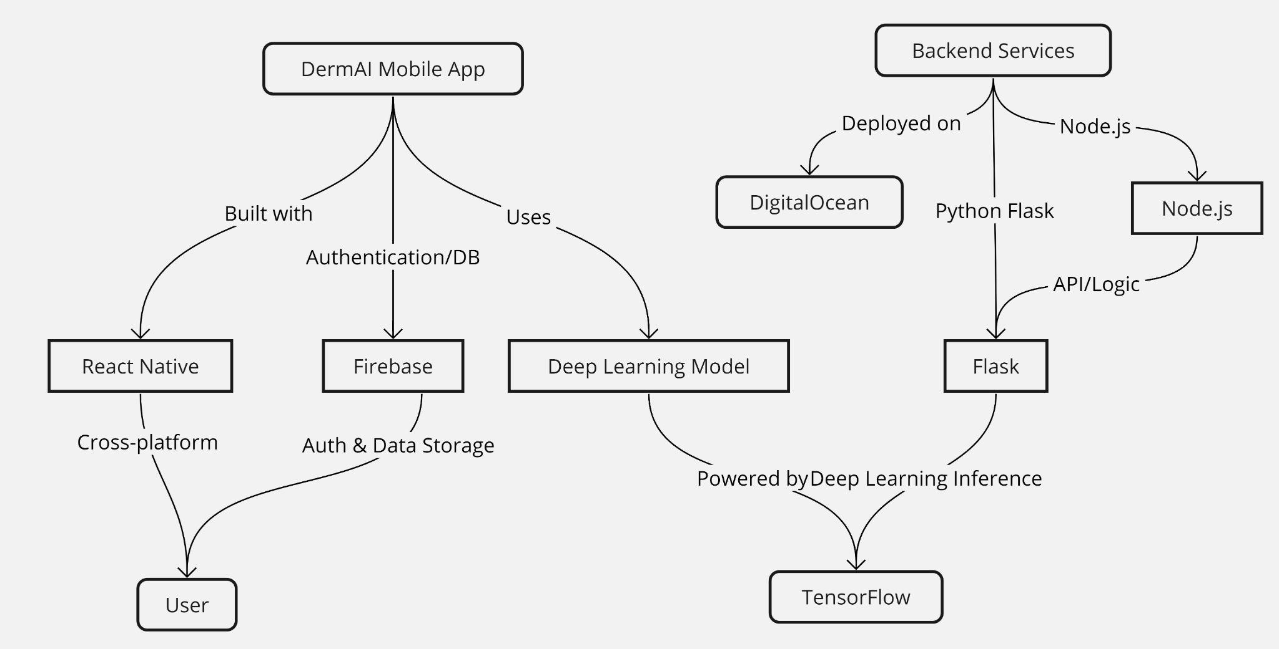
Conceptual Architectural Diagrams

Slide 22
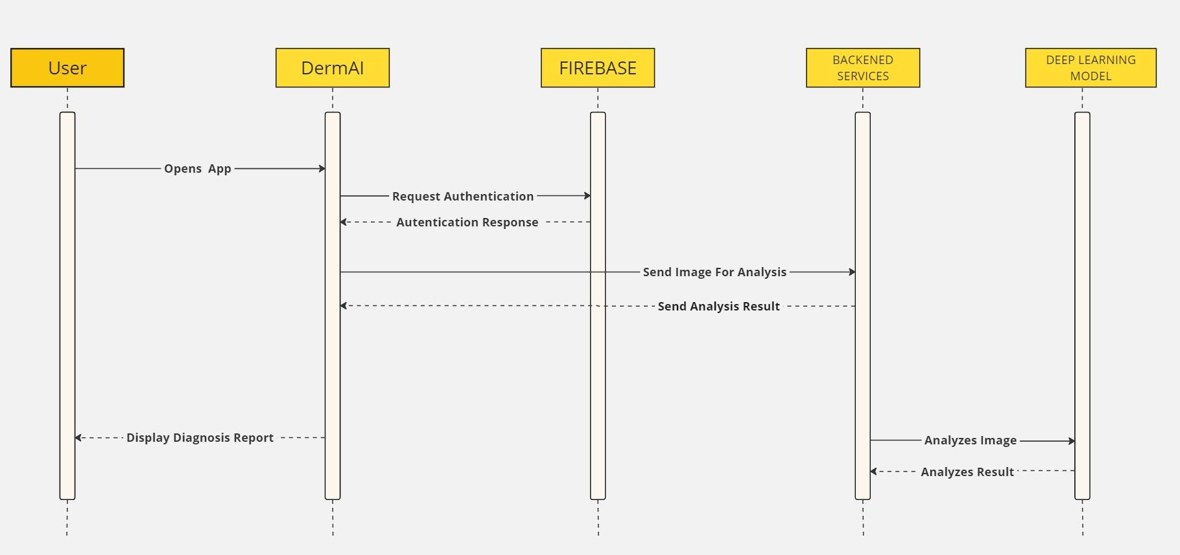
Sequence Diagrams

Slide 23
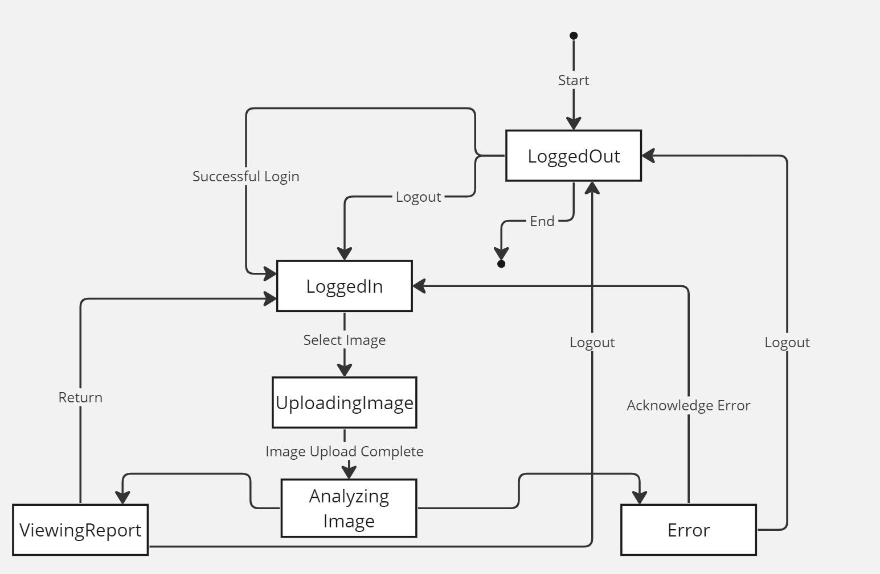
State Diagram

Slide 24
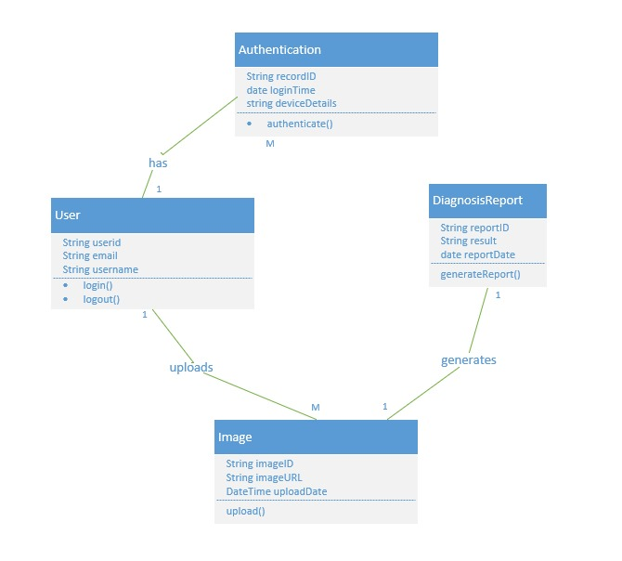
Class Diagram

Slide 25
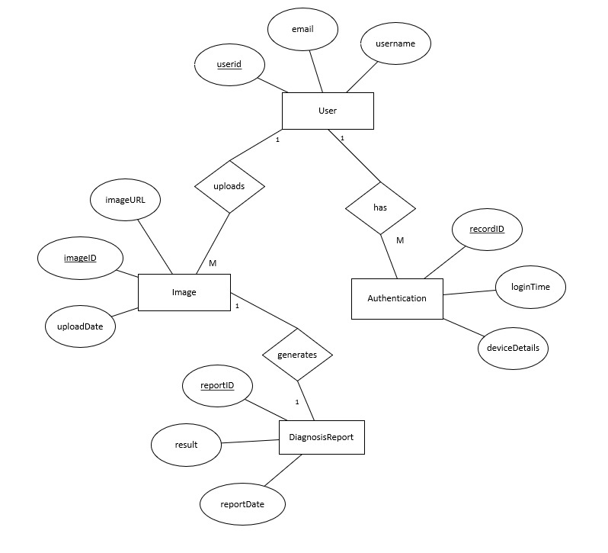
Entity Relationship Diagram

Slide 26
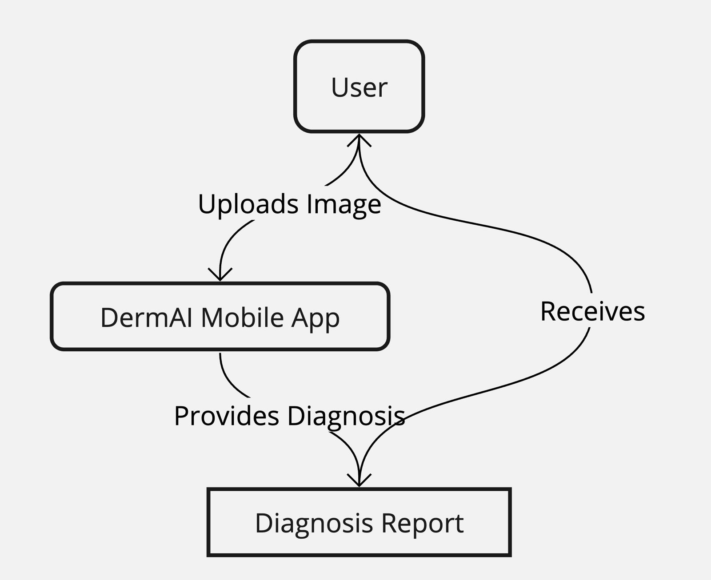
Context Diagram

Slide 27
Sprint 3 recap
Machine learning component has been completed and is able to detect the skin disease
Uploading image functionality has been completed.
API is built and it is able to connect with the client side, so user can upload the image and get the feedback by the analysis.

Slide 28
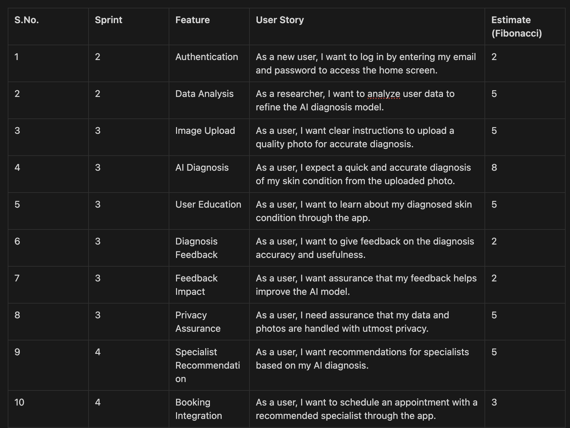
Product Backlog

Slide 29
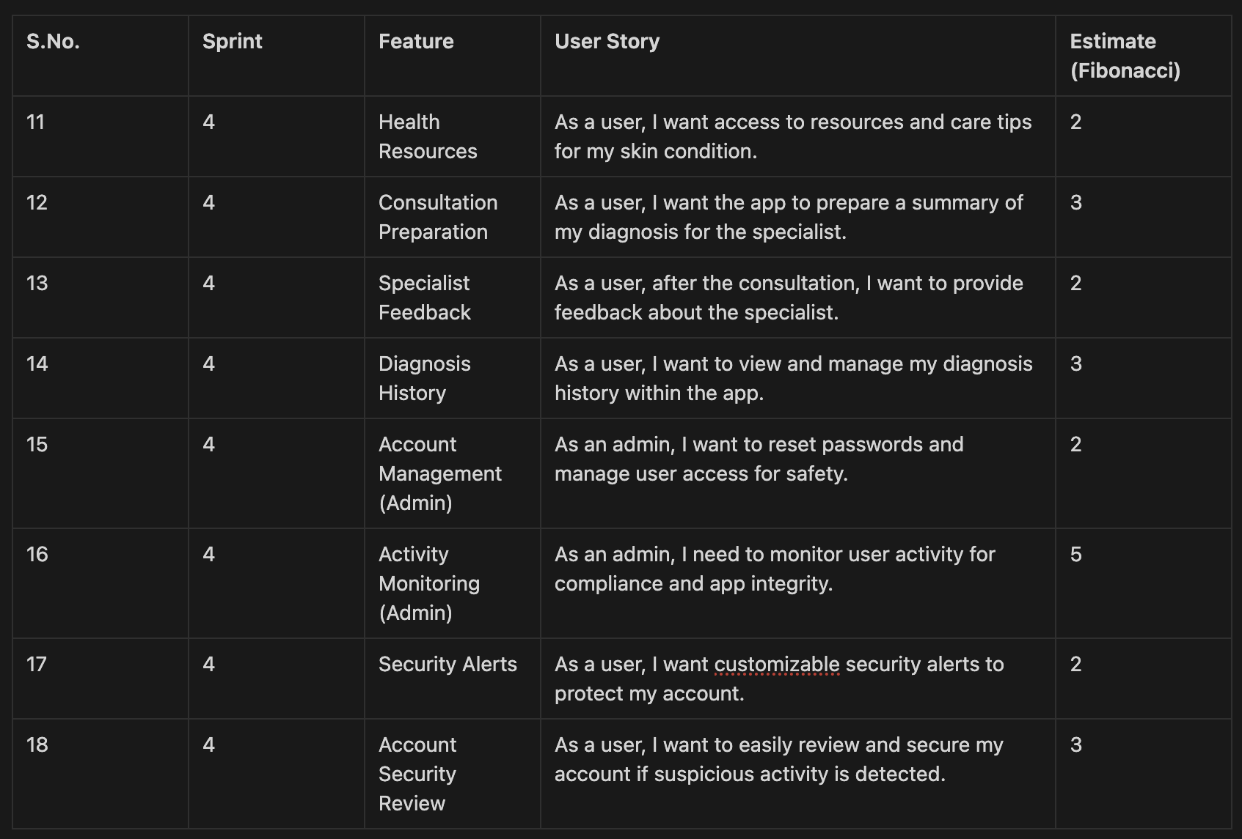
Product Backlog

Slide 30
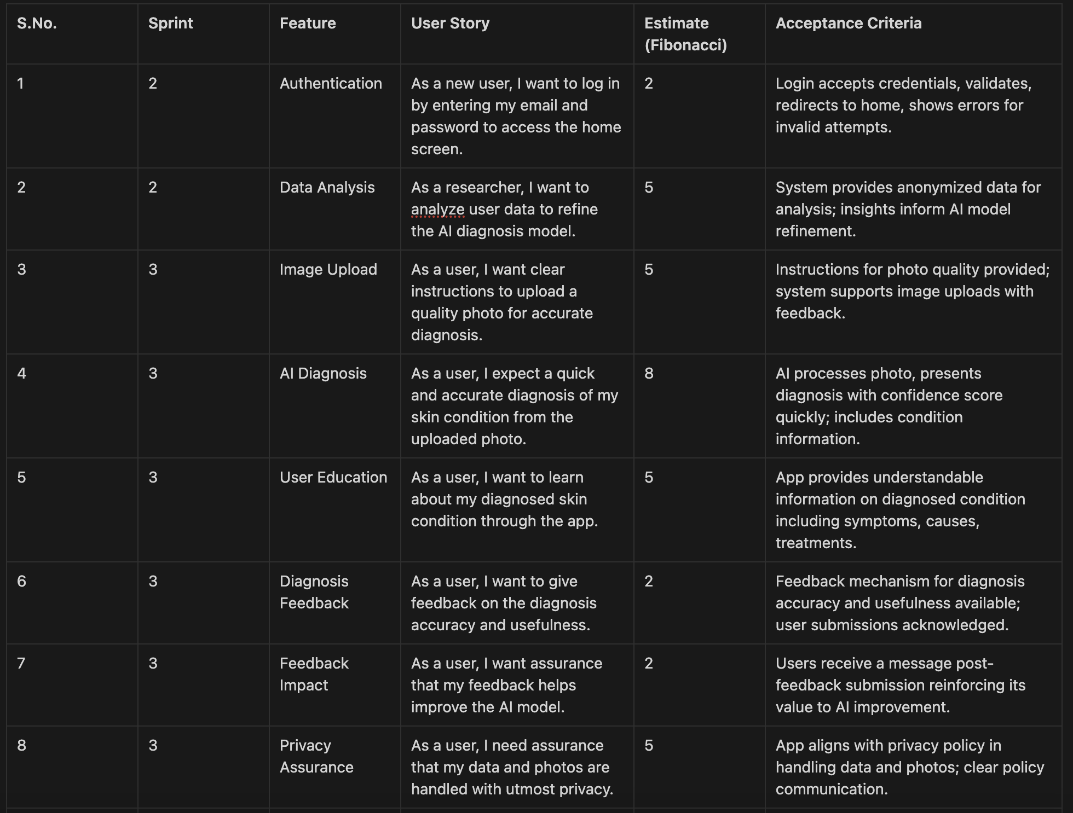
User Stories and Acceptance Criteria

Slide 31
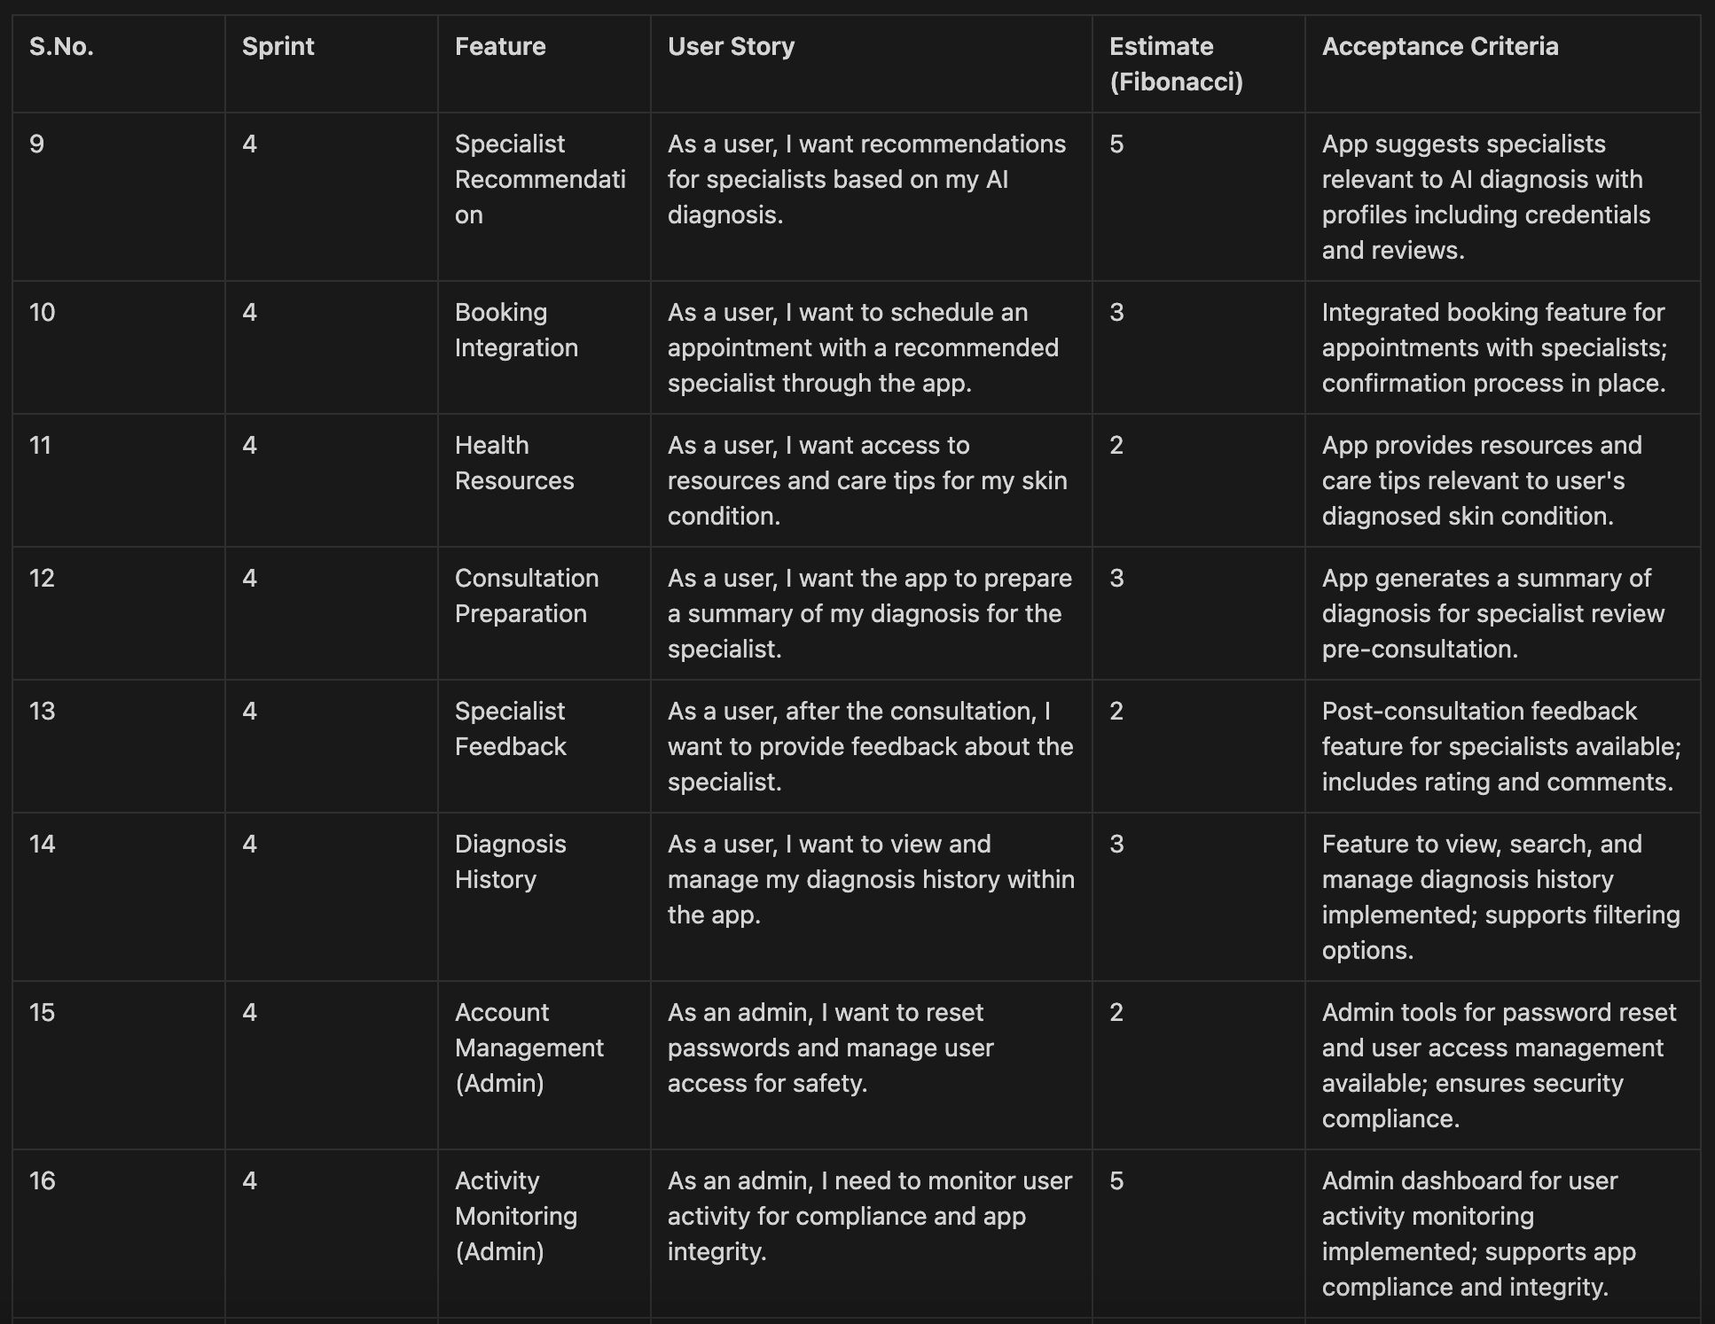
User Stories and Acceptance Criteria

Slide 32
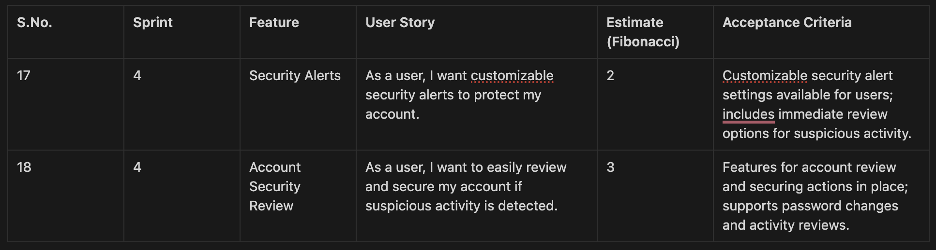
User Stories and Acceptance Criteria

Slide 33
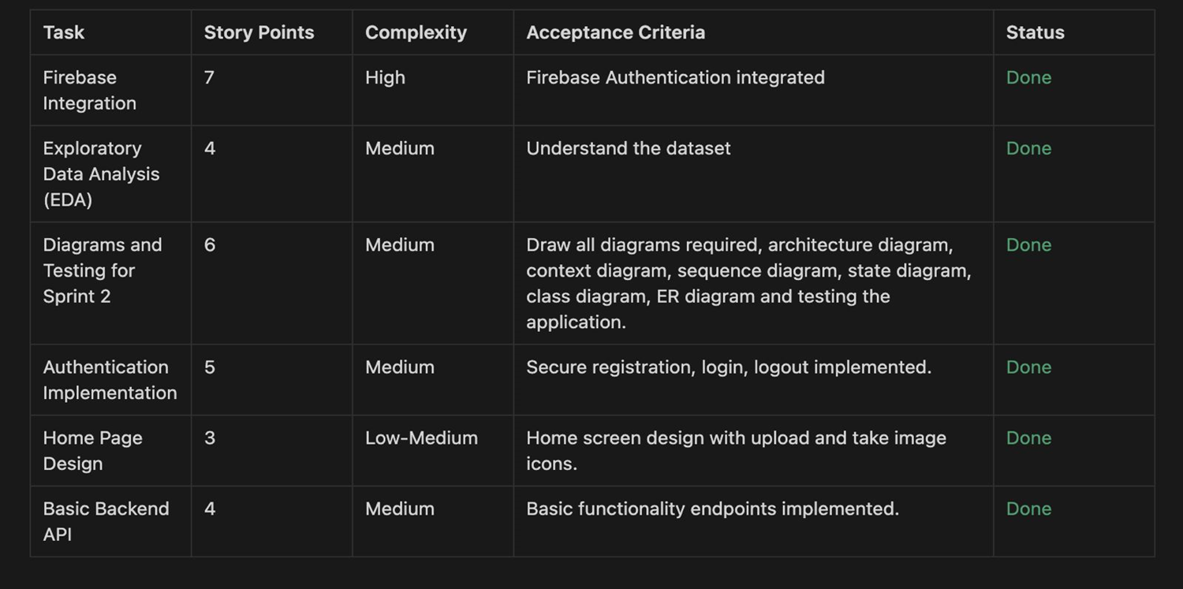
Sprint Summary
Sprint 2 Tasks and user stories

Slide 34
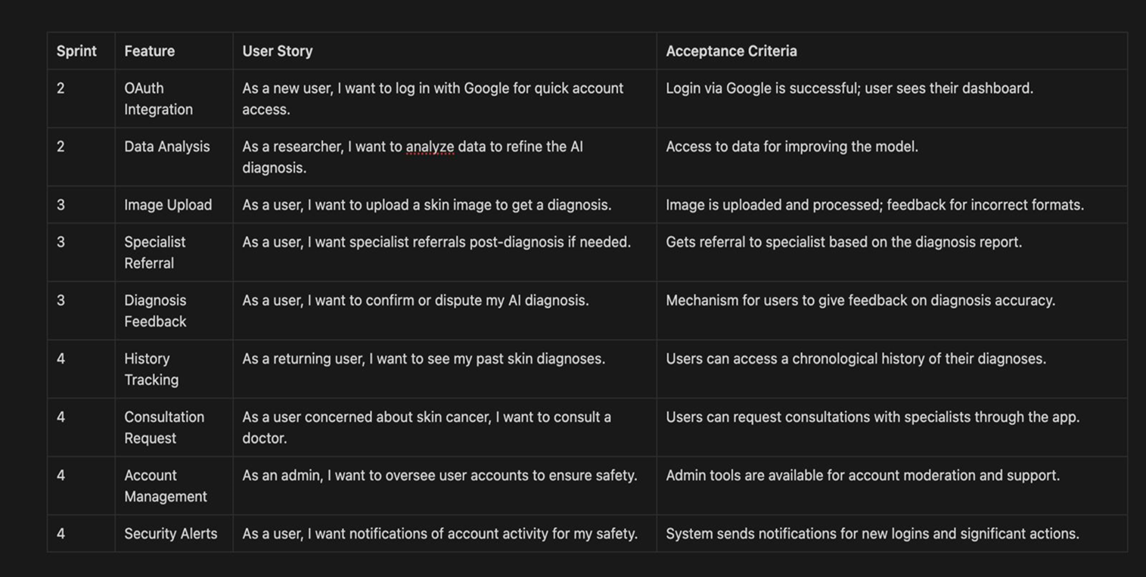
User stories

Slide 35
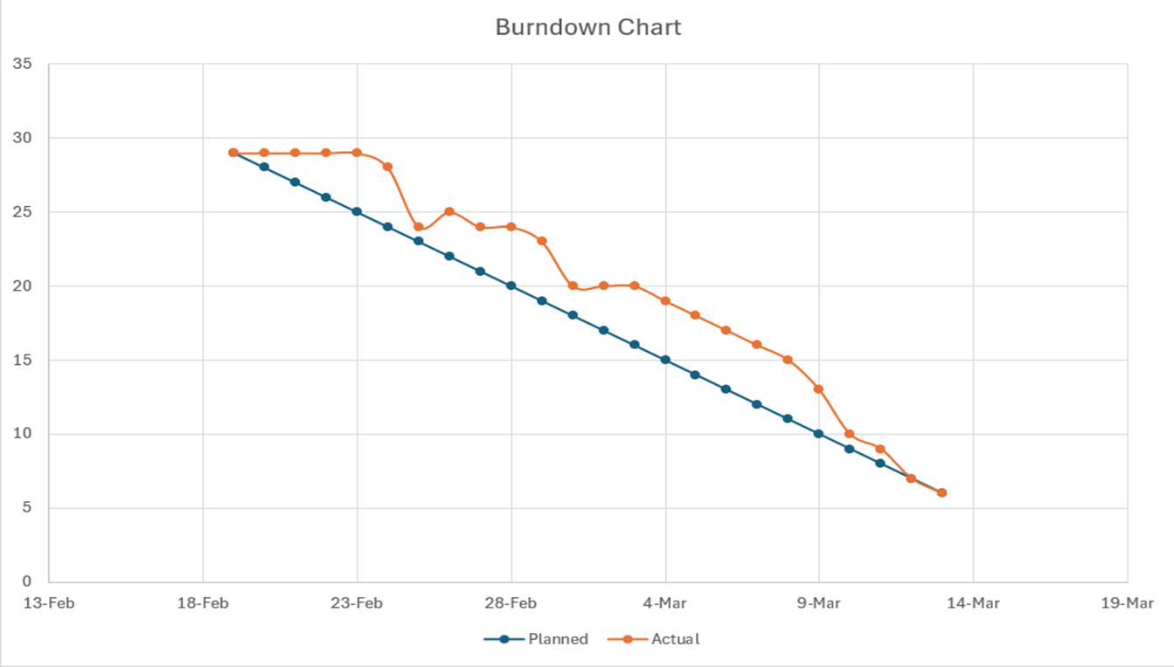
Sprint 2 burndown chart

Slide 36
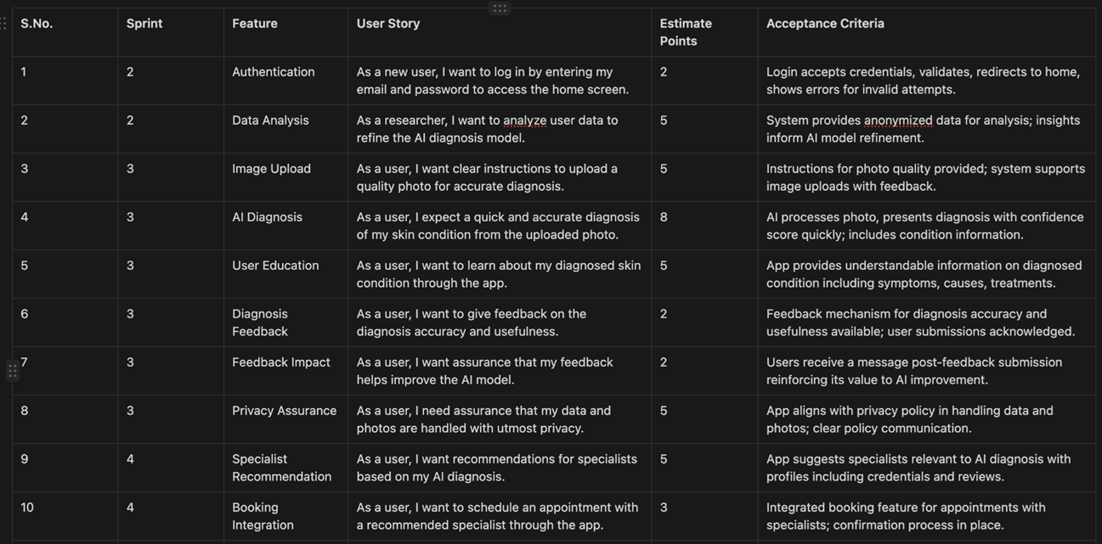
Sprint 3 tasks and user stories

Slide 37
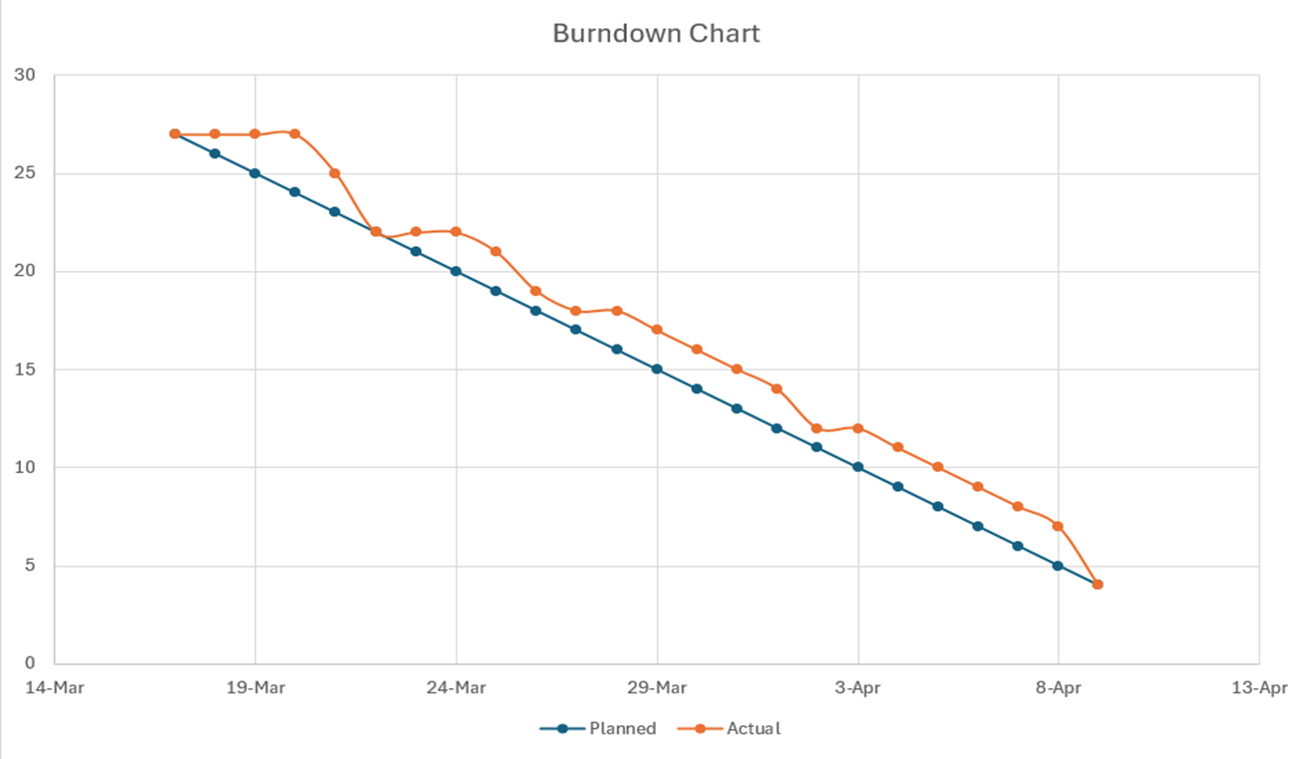
Sprint 3 burndown chart

Slide 38
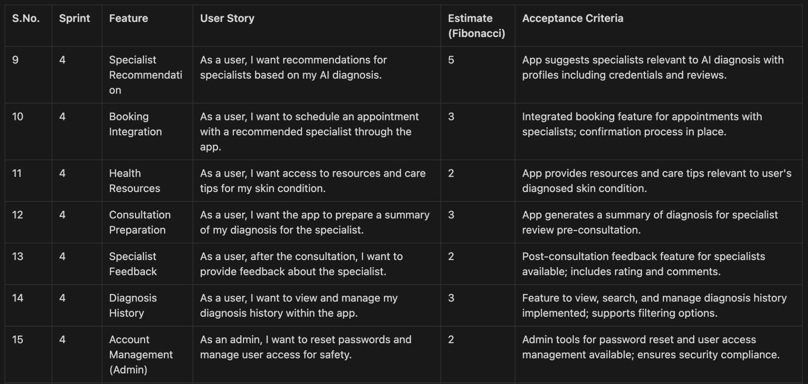
Sprint 4 backlog

Slide 39
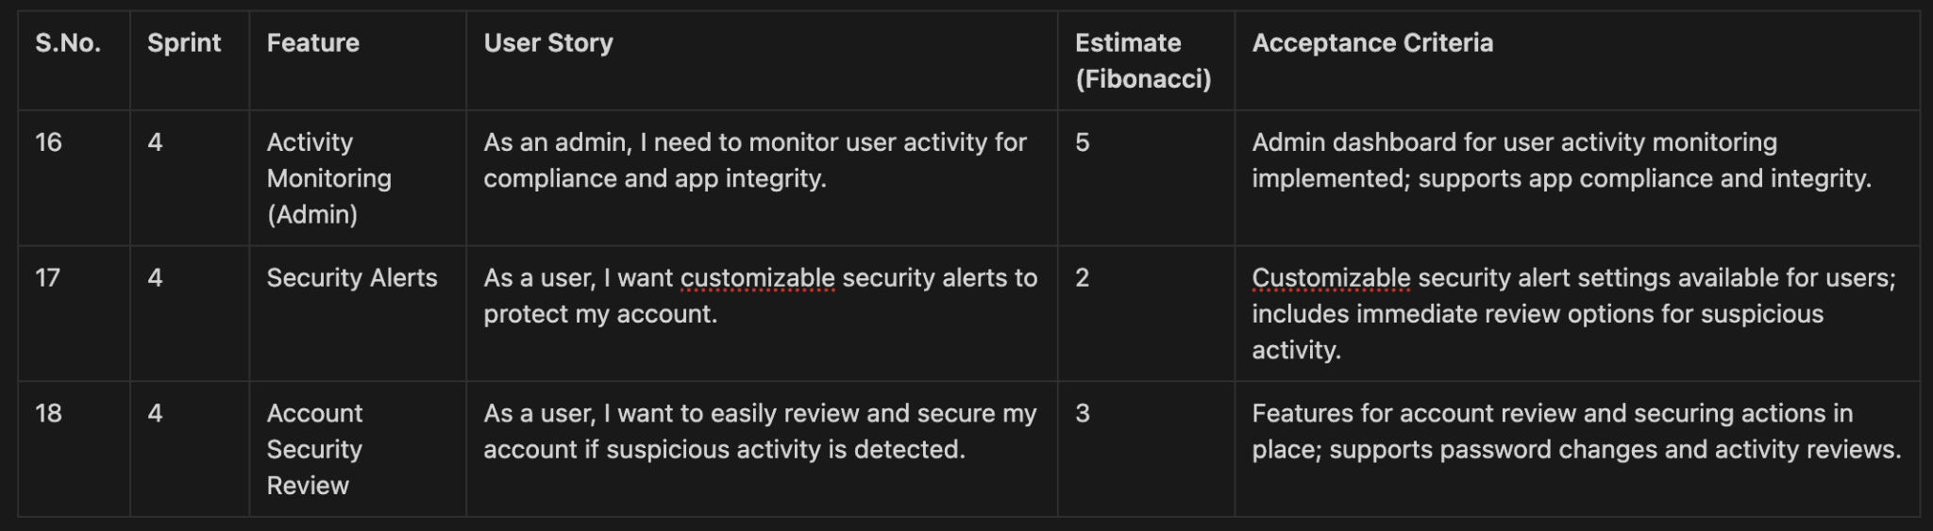
Sprint 4 backlog

Slide 40
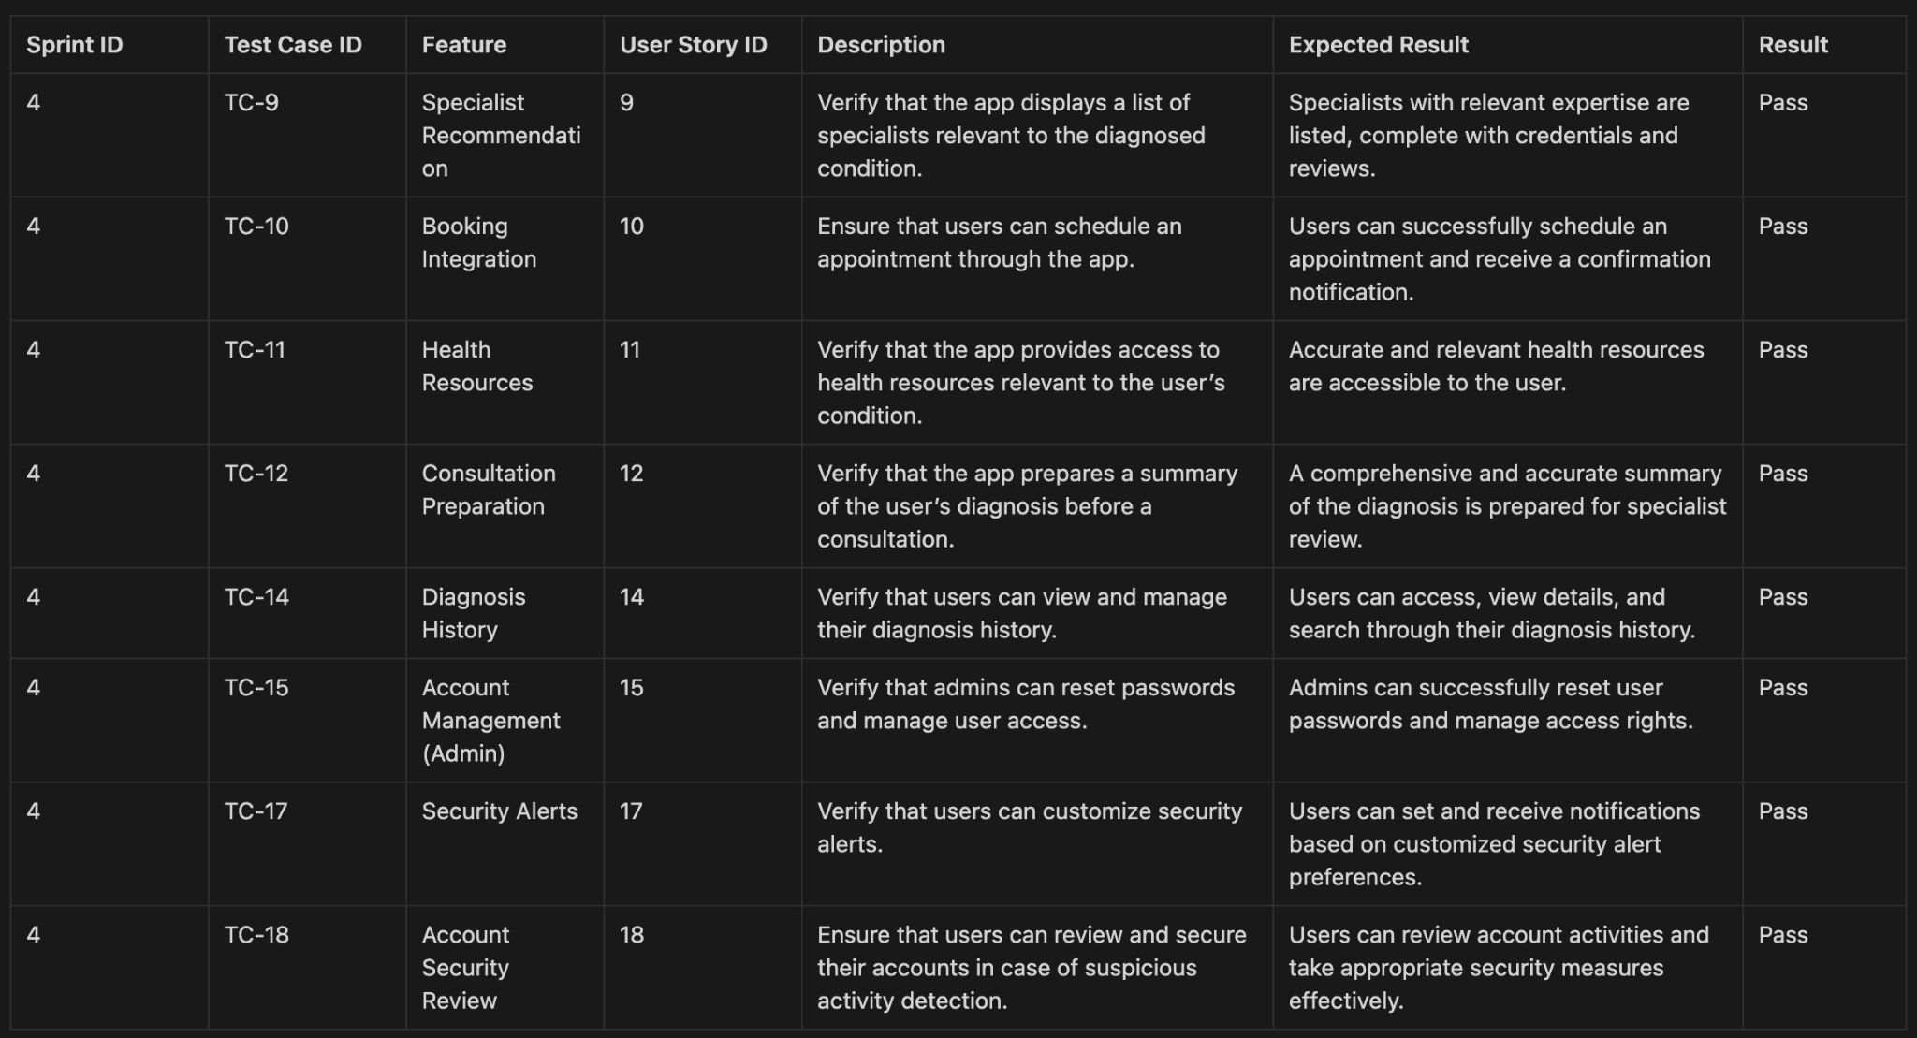
Test Cases for sprint-4

Slide 41
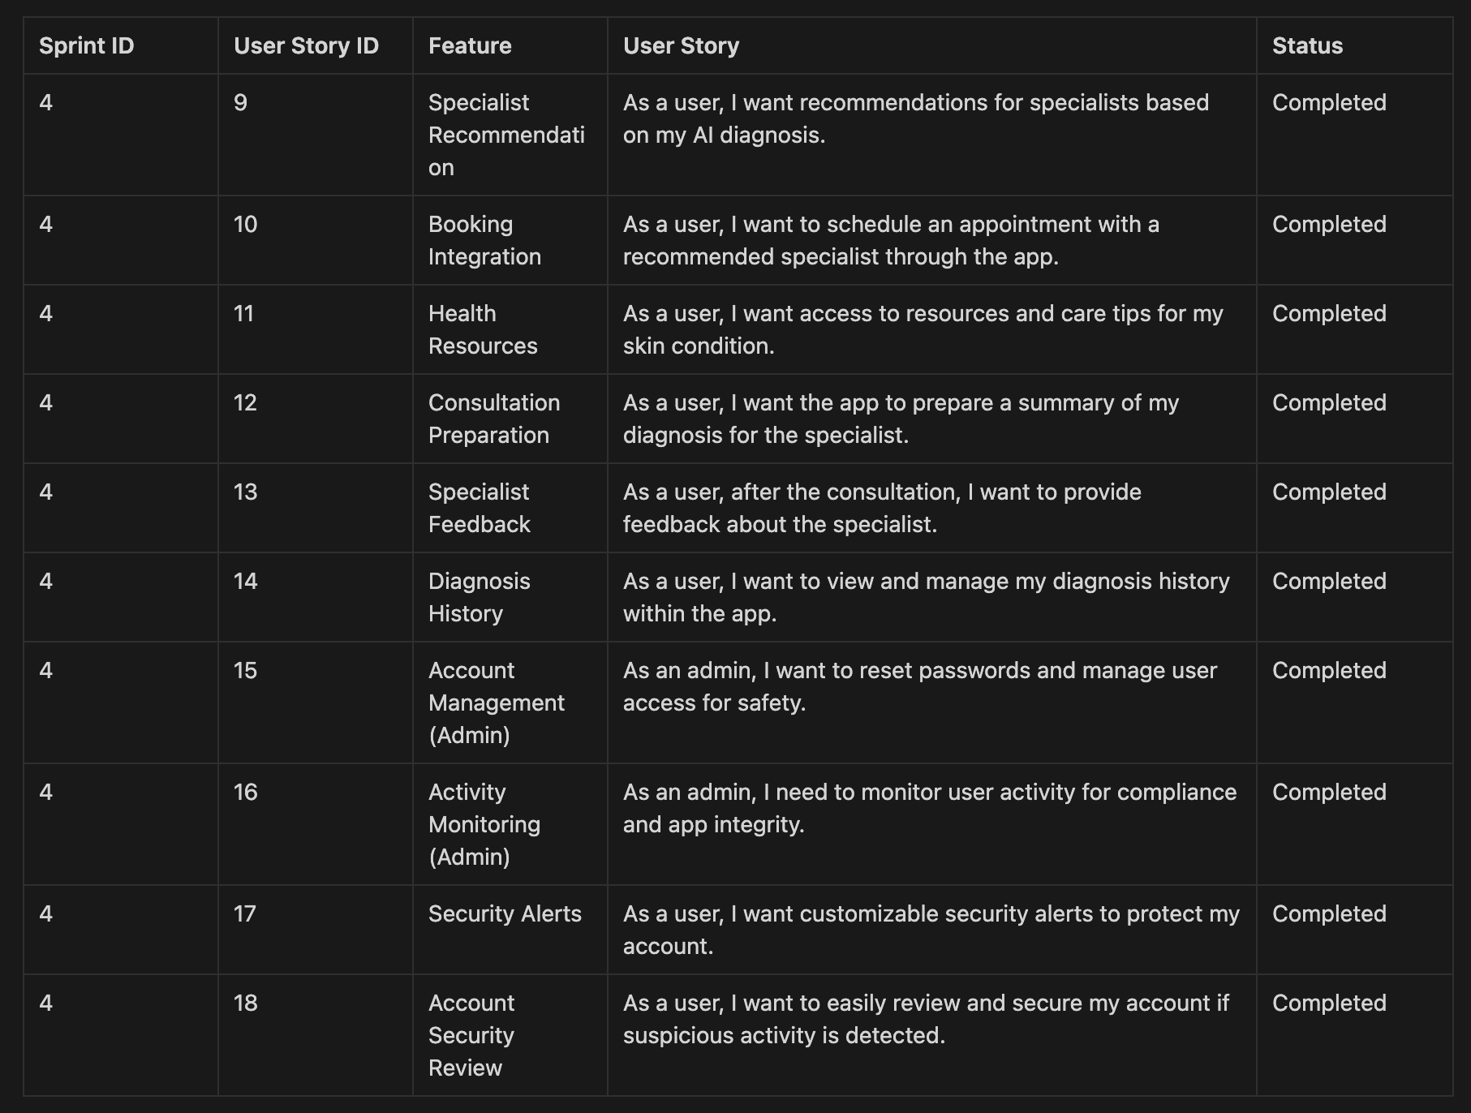
Stories Completed

Slide 42
Team Velocity
5+3+2+3+2+3+2+5+2+3 = 30 Story Points

Slide 43
Team's Historical Velocity (Average)
Sprint 2 Velocity: 29 Story Points
Sprint 3 Velocity: 27 Story Points
Sprint 4 Velocity: 30 Story Points
Average Velocity: 29+27+30 / 3 = 28.6 points

Slide 44
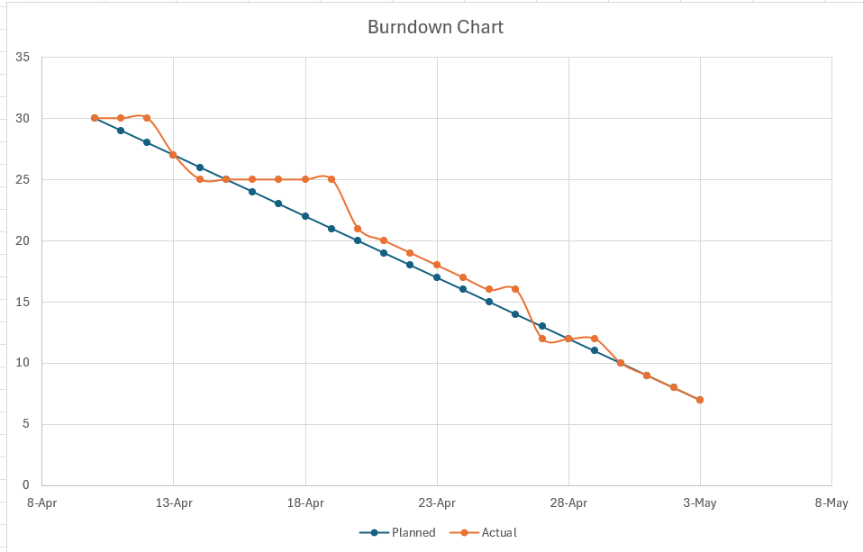
Burndown Charts

Slide 45
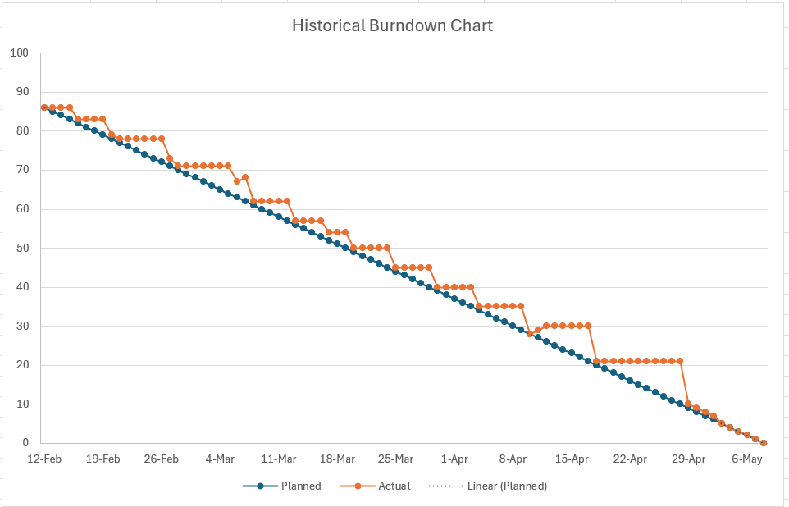
Historical burndown chart

Slide 46
Completed/Committed Ratio (current and average)
Completed Committed Ratio for Sprint 4: 30/30 - 100%
Average Completed Committed ratio for sprint 3 and 4 - (27/27 +30/30 )/2 =100%

Slide 47
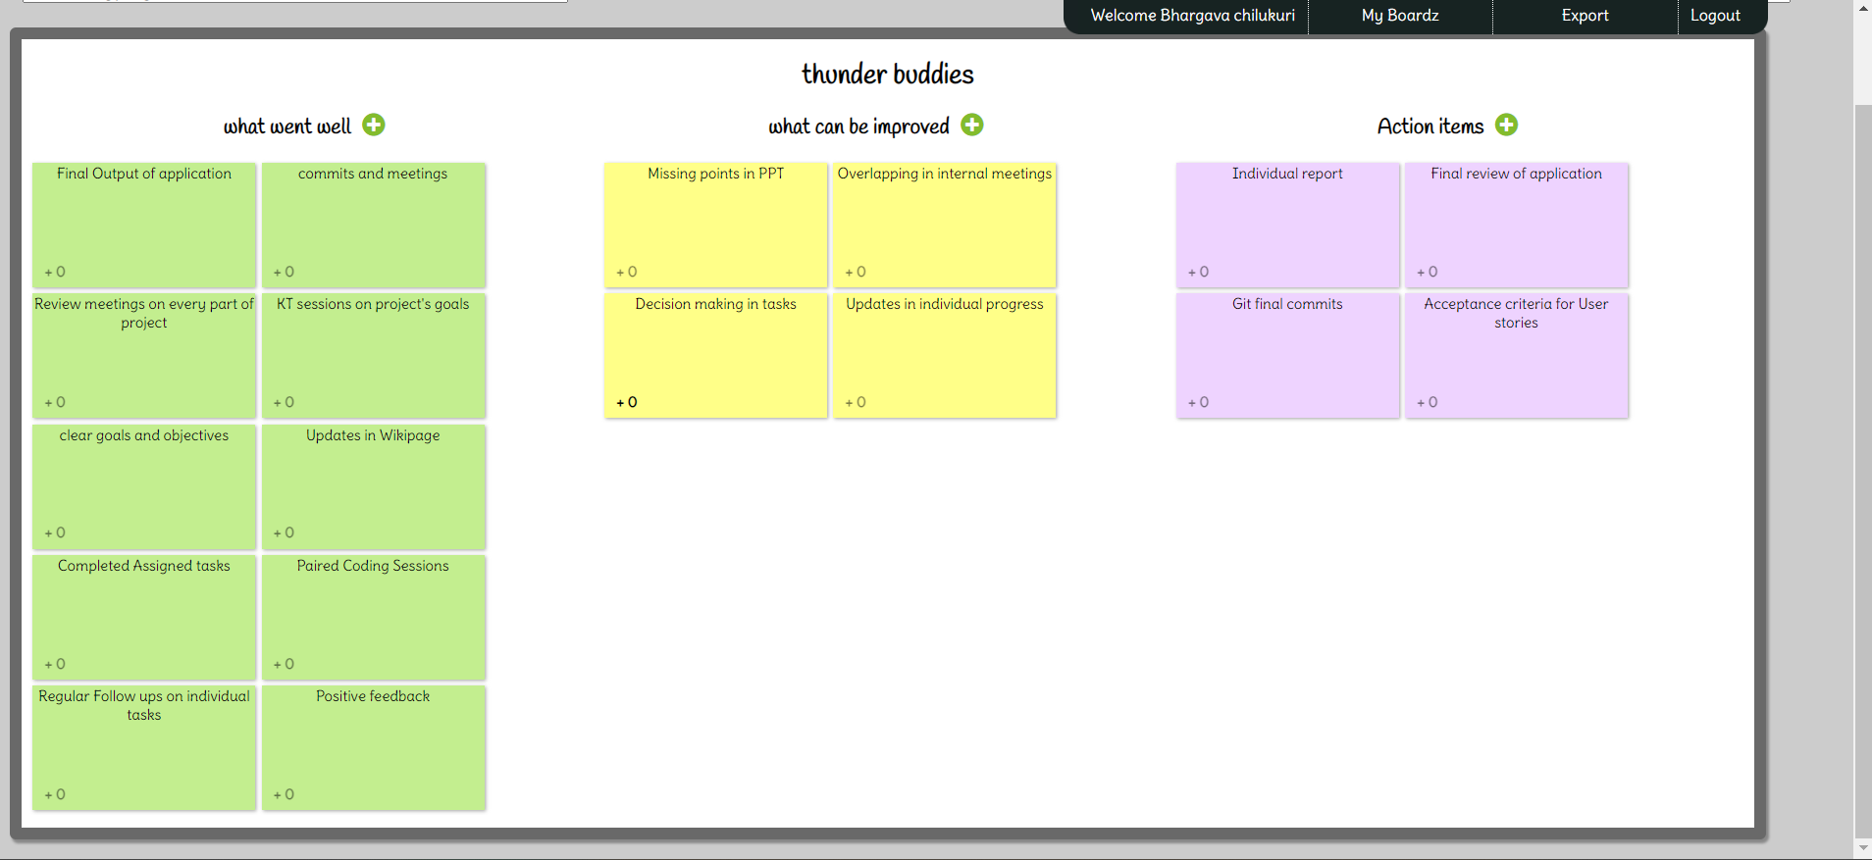
Retrospective

Slide 48
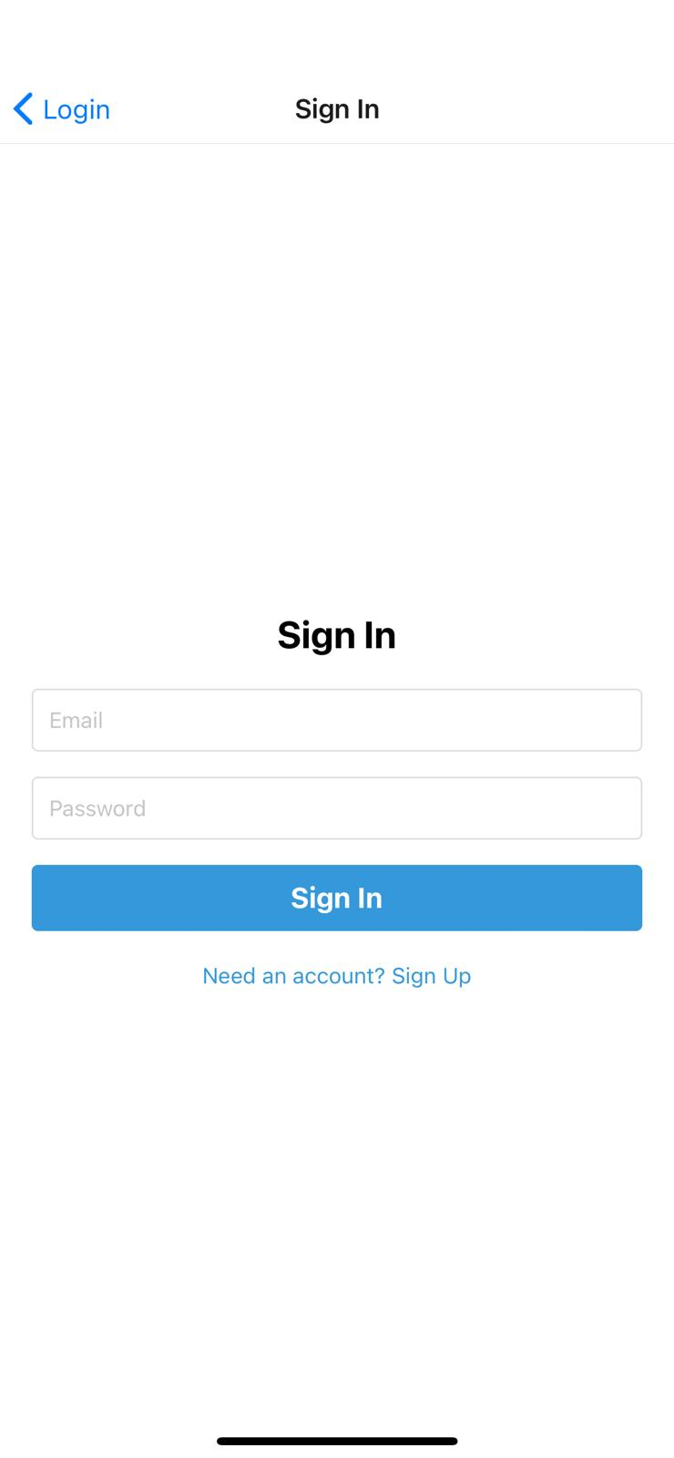
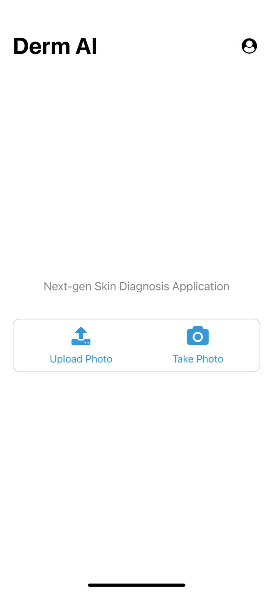
Application Screenshots

Slide 49
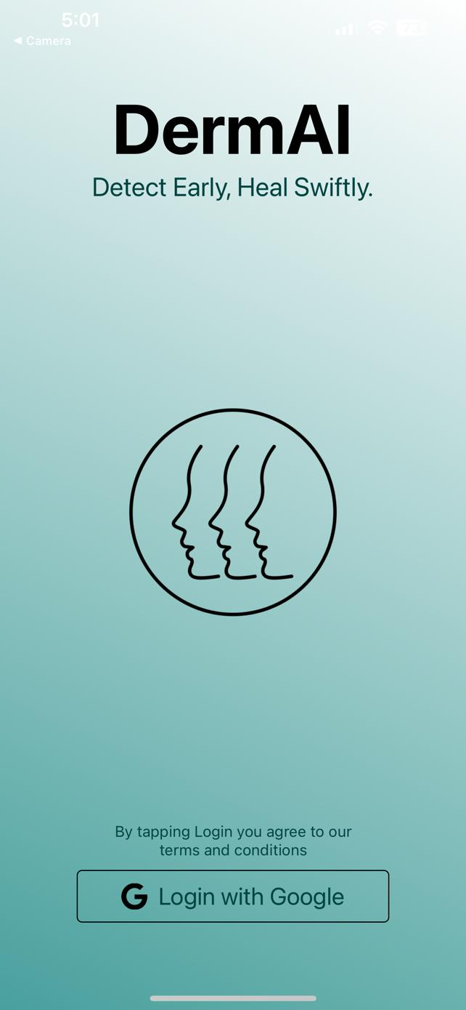
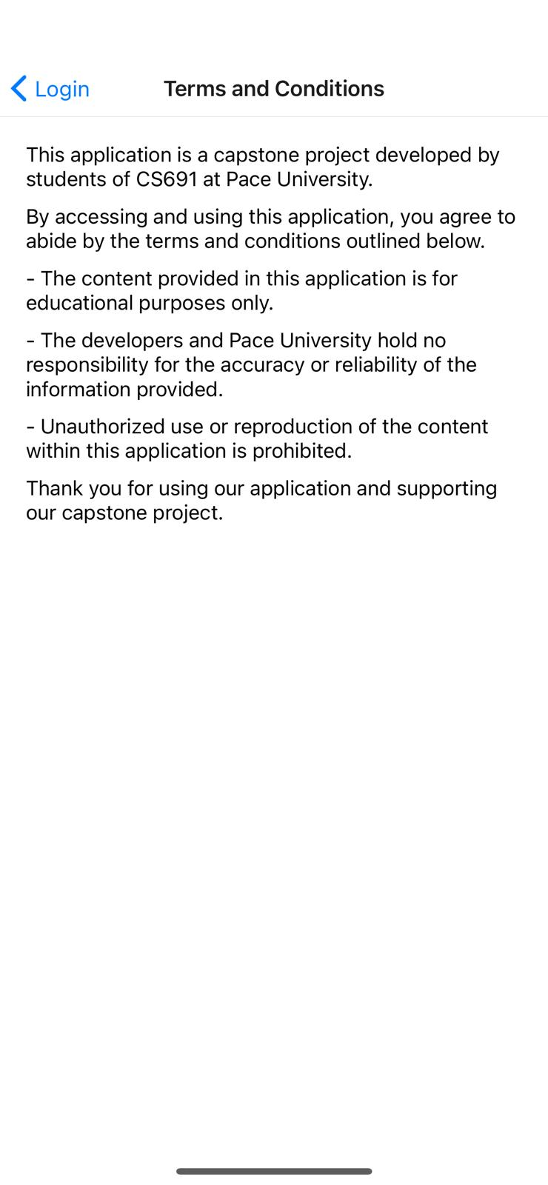
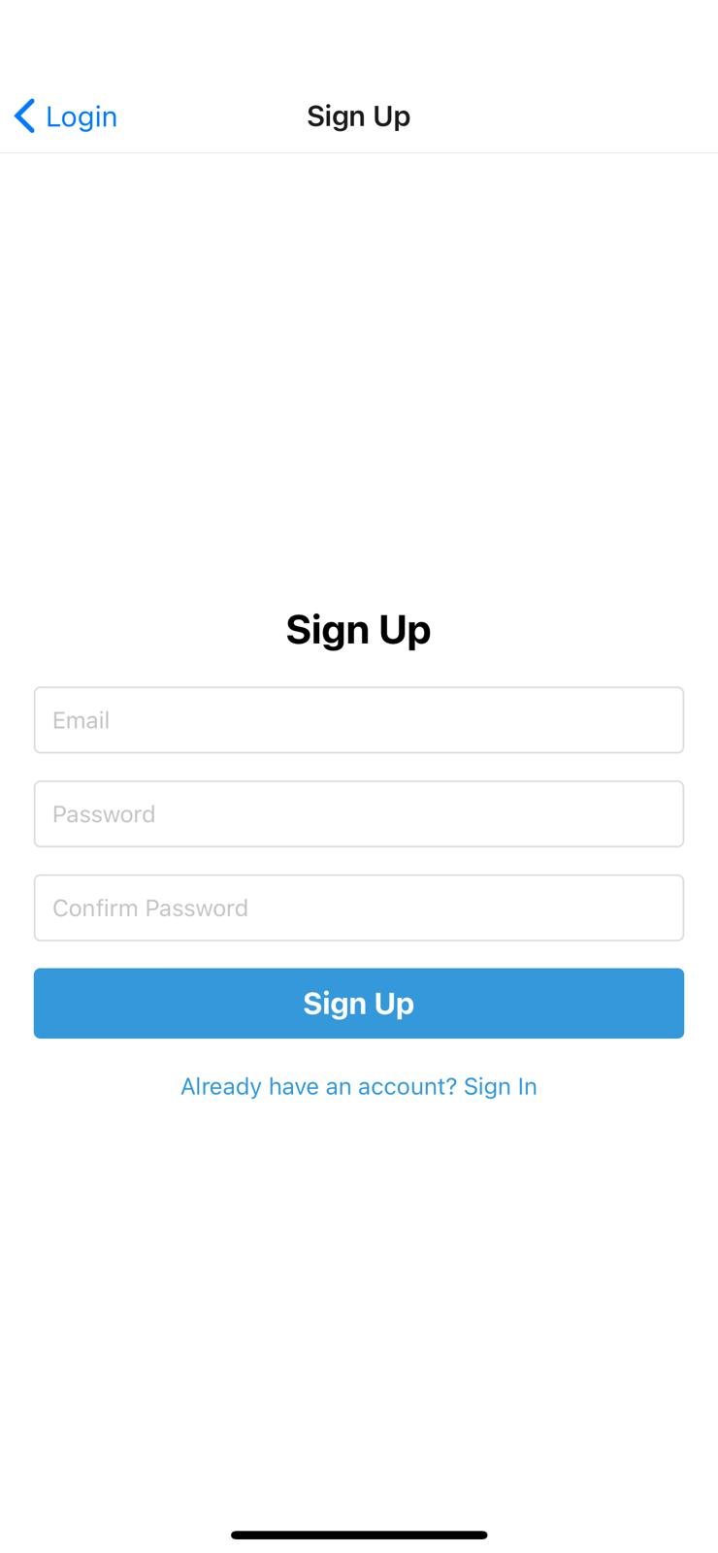
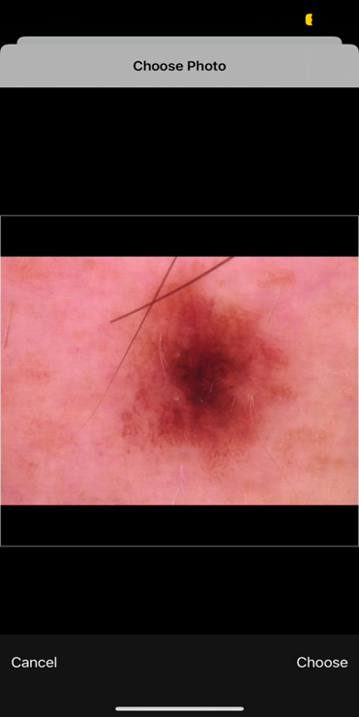
Application Screenshots

Slide 50
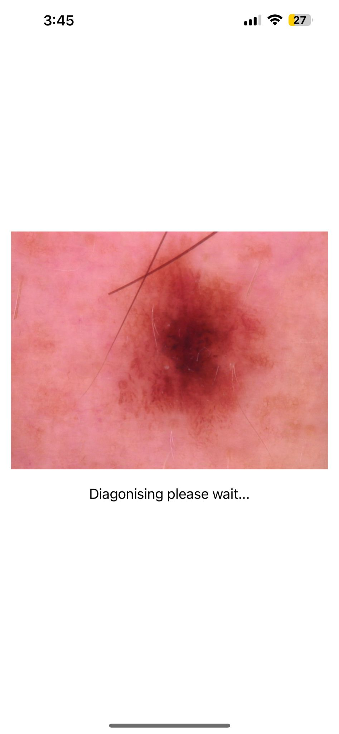
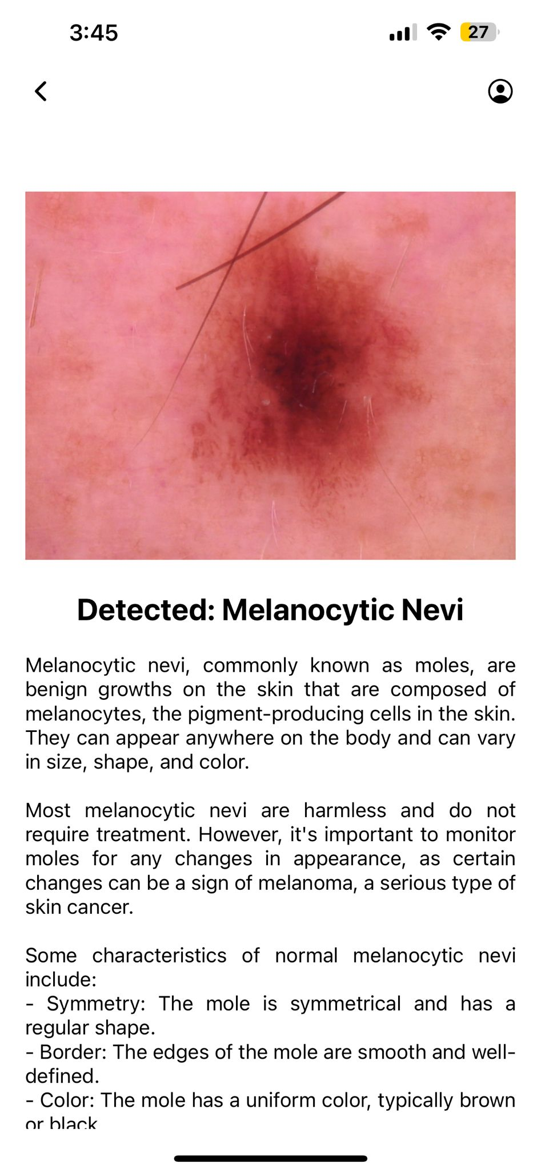
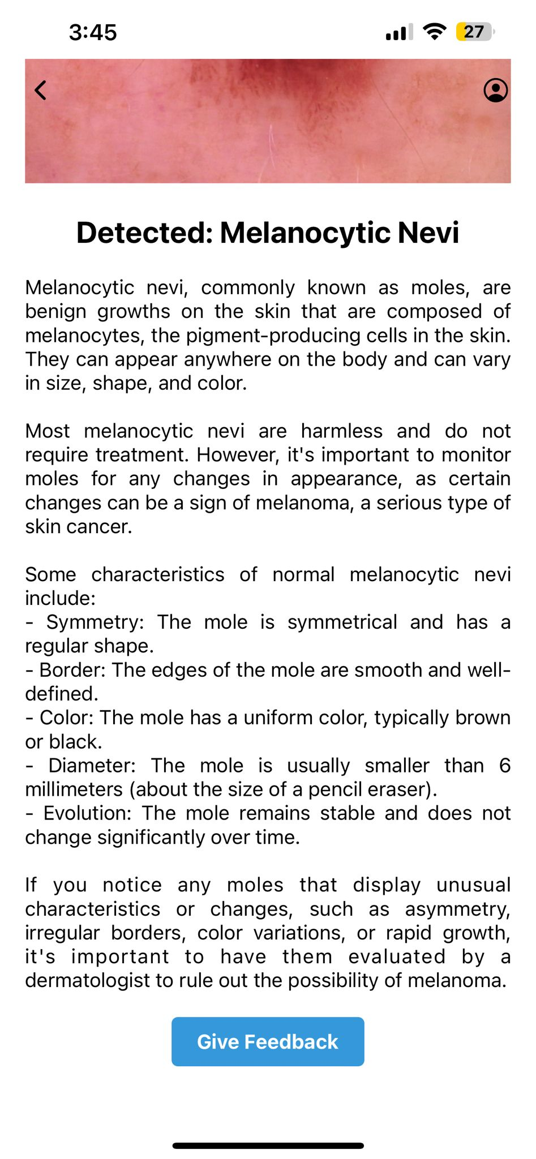
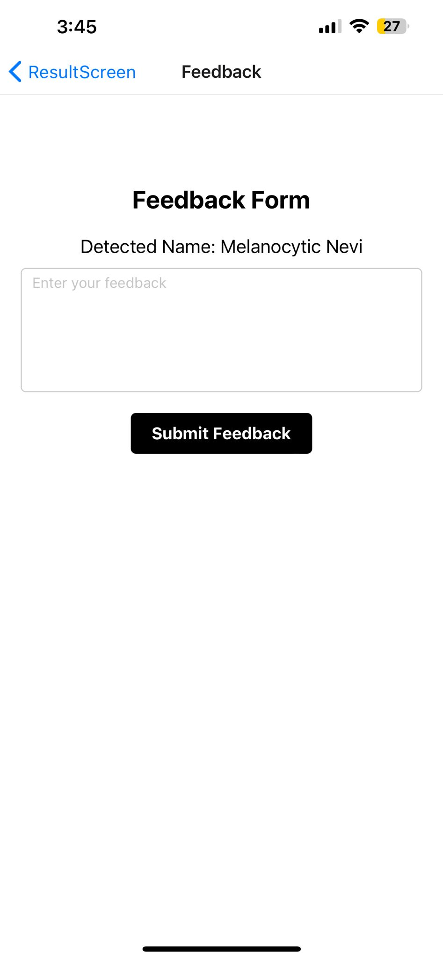
Application Screenshots

Slide 51
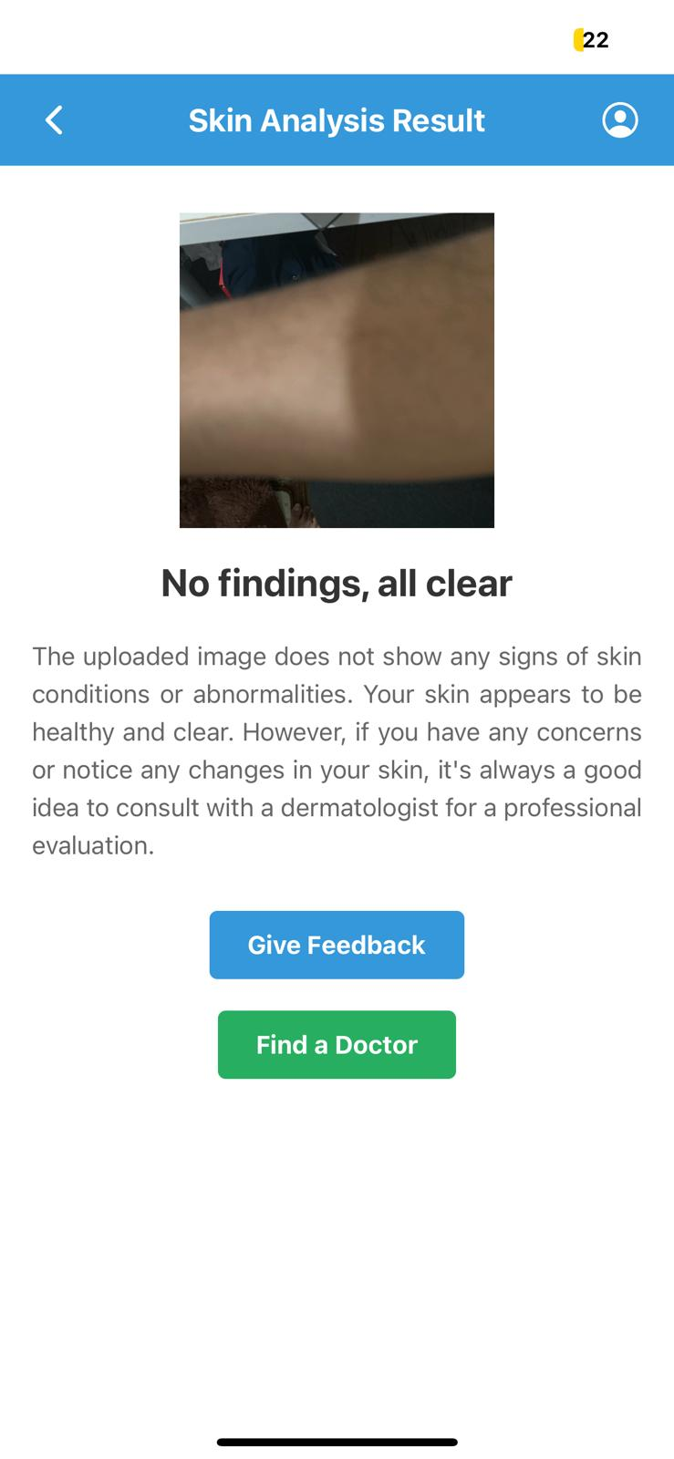
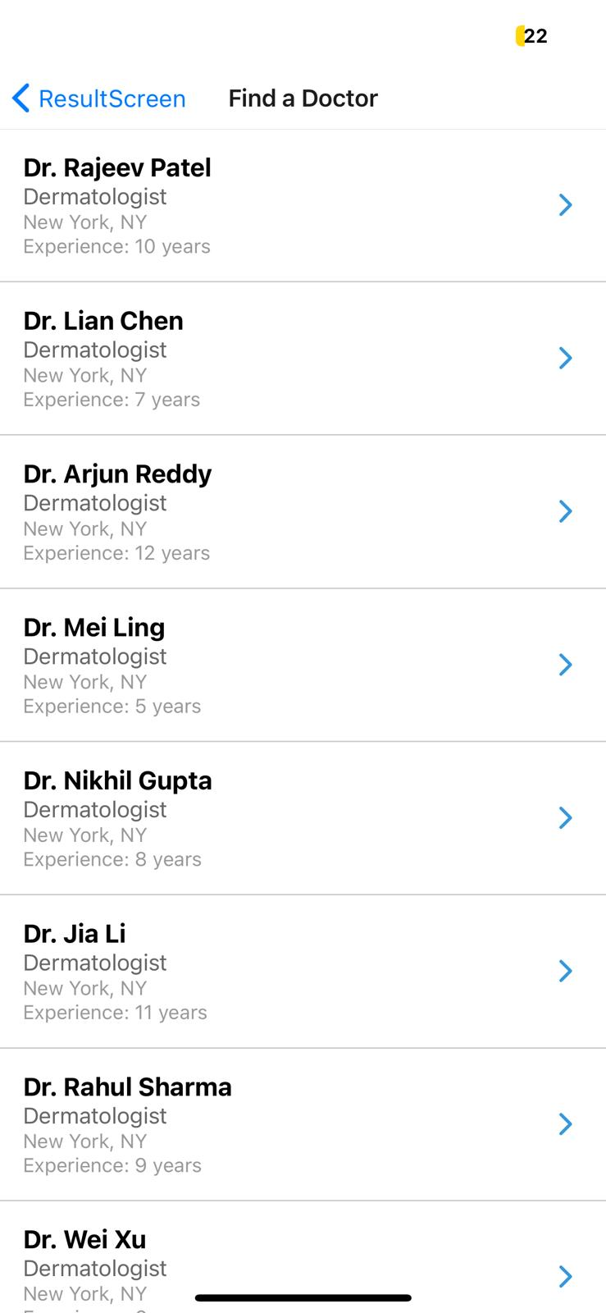
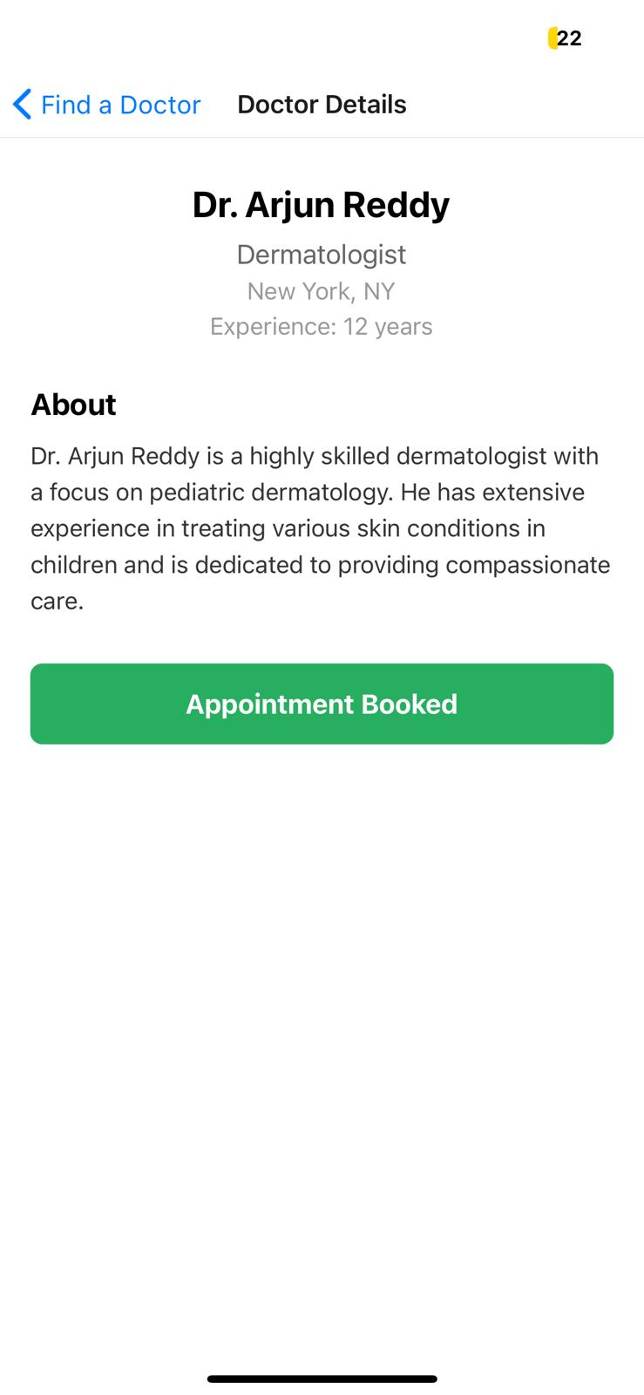
Application Screenshots

Slide 52
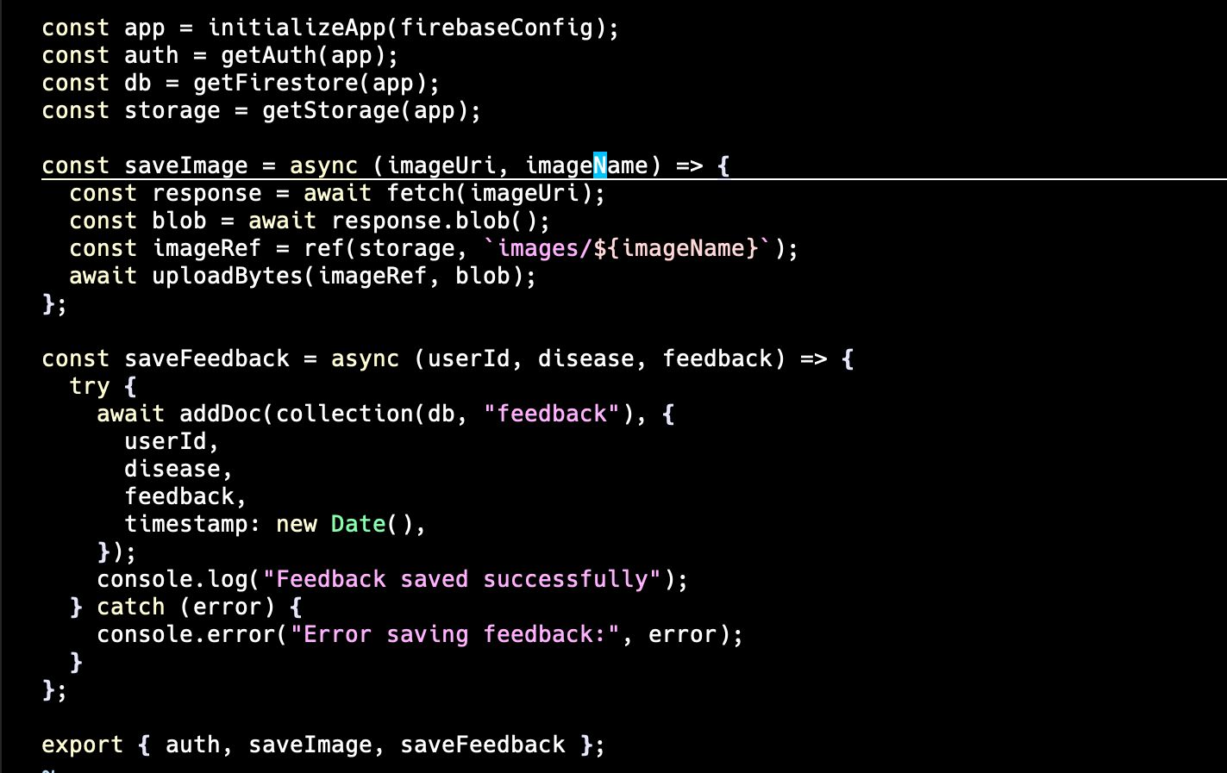
FIREBASE API

Slide 53

Flask API

Slide 54
WikiPage
https://github.com/htmw/2024S-Thunder-Bubbies/wiki

Slide 55
Application Demo
We would be presenting application demo of our project in this presentation

Slide 56
Thank you

